Slide 1
Finding the needle in the haystack
Convergence of techniques
at the inflection point of liquid biopsy
Michele Canzi
National Cancer Institute Symposium on Charting the Course of Liquid Biopsy in Precision, Prevention and Treatment December 15-16, 2021
michelecanzi@gmail.com
@michelecanzi

Slide 2
Agenda
The Schelling point of liquid biopsy
The convergence of multiple trends
The liquid biopsy market
A snapshot of the competitive arena
The needle in the haystack
The central challenge in liquid biopsy
The eye of the needle
Zoom in on a promising liquid biopsy platform under development

Slide 3
The Schelling point of liquid biopsy
Schelling point
In game theory, a ‘Schelling’ or focal point is a solution that people tend to choose by default. The point at which all elements or aspects converge.

Slide 4
The purpose of innovation
The purpose of innovation is to reduce scarcity
Breakthroughs are faster, cheaper, better. Innovation allows to do more with less
The ultimate purpose of innovation is to reduce mortality
Mortality is the ultimate scarcity. Life extension is the most important thing we can invent

Slide 5
The dawn of liquid biopsy
Liquid biopsy publications
2000
1750
1500
1250
1000
750
500
250
0
 |  |  |  | First clinical validation of ctDNA analysis
 | First commercial prenatal diagnostic tests using fetal cfDNA
 |  |  |  |  |  |  |  |  |  | Analysis of copy number variations in cfDNA by whole genome sequencing
Number of PubMed publications
2010
2011
2012
2013
2014
2015
2016
2017
2018
2019
2020
Sources: National Library of Medicine, PubMed

Slide 6
Growth in sequencing volume + drop of unit costs
Growth of DNA sequencing volume Cost declines of genome sequencing
Historical Sequencing Forecast
Number of Human Genome Data Equivalents (3.2 GB)
Moore’s Law Forecast
Cost of sequencing genome
Historic cost per genome
1B
100M
10M
1M
100,000
10,000
1000
100
10
1
$100M
$10M
$1M
$100k
$10k
$1k
$100
$10
$1
Apr Jan Oct Jul Apr Dec Sep Jun Mar Dec ’01 ‘04 ‘06 ‘09 ‘12 ‘14 ‘17 ‘20 ‘23 ‘25
‘98 ‘01 ‘04 ‘06 ‘09 ‘12 ‘14 ‘17 ‘20 ‘23
Sources: National Human Genome Research Institute (NHGRI), Ark Invest

Slide 7
Cancer screening approaching reimbursability
Cancer screening price curves
$2,000 Test
$1,000 Test
$1,500 Test $1,200 Test Willingness to pay
$1,500 Tests
$1,500 tests to unlock cancer screening market for 65-80 year-olds
$350k
$300k
$250k
$200k
$150k
$100k
Incremental cost/ LIfe-year gained¹
Sub-$1,000 Tests
At $1,000, nearly all 40+ year-olds could be screened for cancer
$50k
Eligible for Reimbursement
($100,000/Life-Year (LY) Threshold)
$0
20 30 40
50 60
Patient Age
70
Sources: National Human Genome Research Institute (NHGRI), Ark Invest

Slide 8
Liquid biopsy for lifespan extension
Lifespan at 65
84.0
1970s — Today
Therapy advances added ~1.5 years of life per decade
Average lifespan of cancer patients increased by ~5.5 years
84
83
82
81
80
79
78
77
76
75
74
+2.9
80.6
Age
77.7
Today
Over half of that advance by diagnosing cancer early
Life expectancy outcomes that wouldn’t have occurred until 2035
Average lifespan at 65
Average lifespan at 65 with cancer
Lifespan if all cancers diagnosed at Stage I
Source: ARK Invest, “Could Liquid Biopsies Be The Holy Grail in Cancer Diagnostics?”

Slide 9
The liquid biopsy market

Slide 10
Approaching clinical integration
Main liquid biopsy companies
Lucence
100%
Active trials
Currently, +60 active trials with +20k patients across 11 cancer types
Freenome
Natera
95%
Sensitivity (Stage I, II, III, IV)
90%
Delfi Diagnostics
Guardant Health
85%
Size of the bubble: largest trial to date
Validation of assay Regulatory approval Clinical integration
80%
Wide-ranging sensitivity
Early stage sensitivity (I, II) ~5-15 p.p. lower vs. later stages (III, IV)
75%
Grail
70%
Exact Sciences (Thrive)
65%
70%
75%
80%
85%
Specificity
90%
95%
100%
Source: company websites, investor relations reports and scientiﬁc publications, ‘Integrating liquid biopsies into the management of cancer’ (Nature)

Slide 11
Reading the market
Application
Indication
Target
Early detection
Routine screening for cancer signal
Single cancer
Focus on a single indication
ctDNA
Tumor DNA circulating in bloodstream
Therapy guidance
Diagnostics to inform therapy decisions
Multi-cancer
Ability to detect 5-12 indications
CTCs
Tumor cells circulating in bloodstream
Monitoring & surveillance
Monitoring for relapse in cancer patients
Pan-cancer
Potential to detect +50 indications
Exosomes
Extracellular vescicles

Slide 12
A +$100B opportunity
U.S. Liquid biopsy market opportunity by application
$3,500
Therapy guidance
Early detection: $65.0B
30M lower-risk patients, ~$1,000 / test 35M high-risk patients, ~$1,000 / test
$3,000
$2,500
Price per test
$2,000
Early detection
Monitoring & surveillance
Therapy guidance: $2.1B
0.7M patients, ~$3,000/ test
$1,500
Lower-risk early detection
$1,000
$500
High-risk early detection
Monitoring & surveillance: $45.0B
15M patients (survivors), ~$3,000/ test
0
0 5
10 15 20 25 30 35 40 45 50 55
Patients (M)
Late stage
Early stage
Note: price per screening test may vary signiﬁcantly across indications at stages. Market estimates are conservative Sources: GRAIL S-1, Guardant Health Annual Report, SEER Database, ARK Invest

Slide 13
Pan-cancer dilutes sensitivity
GRAIL CCGA study: sensitivity across clinical stages
100%
90%
80%
70%
60%
50%
40%
30%
20%
10%
0%
93%
92%
Cancers detected
All +50 cancers of GRAIL’s Galleri test Prespecified set of 12 high-signal cancers
81%
83%
76%
69%
Sensitivity
55%
39%
43%
Population-based screenings
Given large absolute number of cancers detected by pan-cancer tests, High specificity (i.e. a very low FPR), may be the most effective approach.
18%
Stage I
Stage II
Stage III
Stage IV
Clinical stage
Sources: “Transforming the landscape of early cancer detection using blood tests” by Nature. “Sensitive and speciﬁc multi-cancer detection and localization using methylation signatures in cell-free DNA”

Slide 14
Most investments in ctDNA
Fundraising in liquid biopsy companies, $M (2010 - 2017)
ctDNA companies CTC companies Exosomes companies
$2000
$1800
$1600
$1400
$1200
$1000
$800
$600
$400
$200
0
Funding ($M)
Founded
2010
2011
2012
2013
2014
2015
2016
2017
Source:” Impressive recent fundraisings encourage great promise for liquid biopsy – Interview by Yole Développement - Oct 2018”

Slide 15
The needle in the haystack

Slide 16
The ‘needle-in-the-haystack’ problem
Cancer-related ctDNA to background cfDNA
The main challenge
Detecting mutant-ctDNA in healthy-cfDNA is the main challenge to early detection
Healthy cfDNA: +99%
Needle-in-a-haystack
VAF¹ quantifies the ‘needle-in-a-haystack’ problem and its proportional to tumor size
Tumor fraction (Late-stage): 1%
Tumor fraction (Early-stage): 0.01%
1. VAF = Variant allele frequency
Source: The Exploitable Genomics of Cancer: Earlier Cancer Detection Part II - ARK Invest

Slide 17
Early-stage ctDNA is too rare
Sensitivity curves vs. coverage
100%
95%
85%
75%
Sensitivity needs depth
To have 95% sensitivity at 0.01% VAF
→ 30,000x coverage = 90ng.
Sensitivity
50%
VAF = 10%
VAF = 1%
VAF = 0.1%
VAF = 0.01%
VAF = 0.001%
Early stage VAF
Depth penalty
Error correction needs +5-10x read depth
30kx req. depth = 150-300kx raw depth
0%
10x 30x 100x 300x 1,000x 3,000x 10,000x 30,000x 100,000x
30pg 90pg 300pg 900pg 3ng 9ng 30ng 90ng 300ng
Unique read depth (Coverage)
Source: Phallen J et al Sci Transl Med 2017

Slide 18
From needle to haystack
Somatic DNA mutations
DNA Methylation
Multi-omics
Somatic DNA mutations in oncogenes that provide reliable tumor signal
Machine learning to surface DNA methylation and detect cancer earlier
Multiple ‘omics machine learning models that incorporate many signals
[...]
cfRNA profiling Circulating proteomics Fragmentomics Methylation signature ctDNA
Methylation signature
ctDNA
ctDNA
Causal
Needle
Correlative
Haystack
Source: The Exploitable Genomics of Cancer: Earlier Cancer Detection Part II - ARK Invest

Slide 19
The potential of NGS methylation
Grail CCGA study (2018): three approaches
1. Whole-genome sequencing
2. Targeted somatic mutation
3. Targeted methylation sequencing
Strongest distinguisher.
Outperforming WGS and targeted sequencing
Set of capture probes covers +100,000 methylation regions and +1M methylation sites.
Brute-force solution.
Must sequence everything in sample Large number of uninformative sequences.
Intermediate approach.
Sequence cfDNAs with regions known to differ between normal and cancerous cells.
Richer sequencing accuracy vs. WGS, poor performance on broad set of indications
Can result in higher upfront costs and the need for more bioinformatics.
Source: Epigenetic analysis for early cancer detection (Nature), GRAIL’s website (Cell-free Genome Atlas (CCGA) Study)

Slide 20
Multiomics amplifying signal
‘Needle’ - cancer signal
Somatic DNA mutations Somatic DNA mutations
Somatic DNA mutations Somatic DNA mutations Somatic DNA mutations
‘Haystack’ - ‘omics datasets
Methylomics Proteomics
Immunomics Fragmentomics
Proteomics, Methylomics, Transcriptomics
Source: company websites and clinical study publications

Slide 21
The ‘eye of the needle’

Slide 22
The ‘eye of the needle’: ultra-short ctDNA
ctDNA with EGFR mutation in blood, detectable range by NGS & PCR
Ultrashort ctDNA Range of focus for NGS, PCR
No. of ctDNA fragments
20 40 60 80 100 120
Fragment length (base pairs)
140
160
180
200
Sources: Ultra-Short Circulating Tumor DNA (usctDNA) in Plasma and Saliva of Non-Small Cell Lung Cancer (NSCLC) Patients

Slide 23
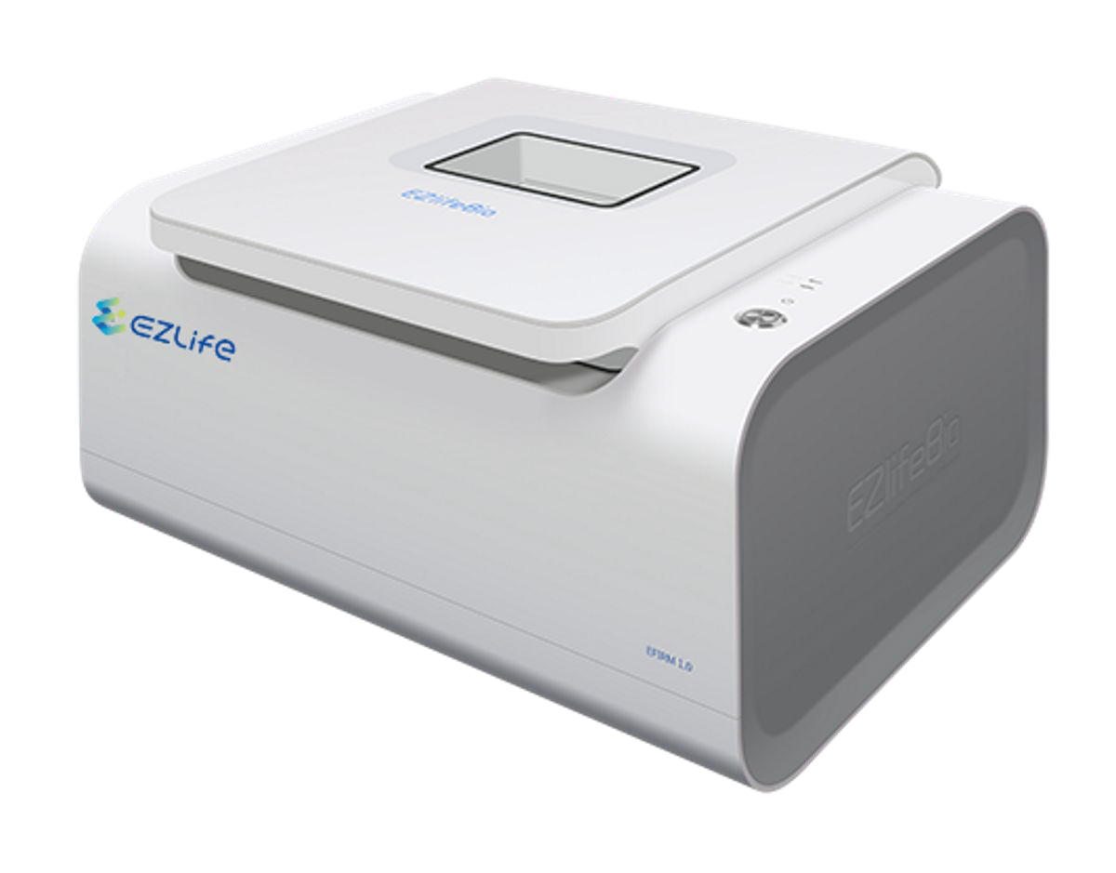
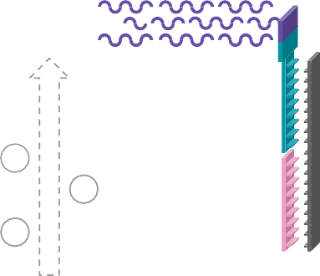
EFIRM, a novel eLB platform
Illustration of EFIRM (eLB) core technology
EFIRM Detection Device Electrochemical-based capture and quantification
Direct, scalable, quick detection
No sample amplification needed, easy to scale for new mutations, rapid turnaround
Conducting polymer HRP
Detection probe
Capture probe ctDNA
Gold plate
TMB⁺ TMB⁻
e
-
e
e
-
-
Technology overview
Sources: Electric Field–Induced Release and Measurement Liquid Biopsy for Noninvasive Early Lung Cancer Assessment

Slide 24
EFIRM outperforms PCR
ddPCR vs. EFIRM detection of EGFR L858R
ddPCR vs. EFIRM detection of EGFR Exon19del
Plasma Saliva
Plasma
Saliva
300
200
100
200
100
1400
1000
600
200
10
8
6
4
2
5000
4000
3000
2000
1000
100
50
Concentration¹
Concentration¹
ddPCR
50
25
800
2000
Current (-nA)
100
Current (-nA)
600
1500
EFIRM
400
200
1000
50
500
ddPCR EFIRM
L858R assays
Exon19del assays
L858R
Exon19del
1. Concentration = (copies/μL)
Sources: Ultra-Short Circulating Tumor DNA (usctDNA) in Plasma and Saliva of Non-Small Cell Lung Cancer (NSCLC) Patients

Slide 25
EFIRM potential at bedside
A ‘Needle’ + ‘Haystack’ test
Illustration of eLB-based screening at bedside (MRD)
EFIRM (eLB)
NSCLC
 | +
Methylomics Fragmentomics Transcriptomics Proteomics Exosomics [...]
+
Non-cancer nodule
Conventional procedures (e.g., CT scan)
NSCLC
survivor
eLB surveillance scan
-
Back to surveillance guidelines

Slide 26
Convergence of techniques to extend lifespan
Convergence of technologies and targets
Lifespan extension of cancer patients
Average lifespan at 65 with cancer
Forecast
Forecast with liquid biopsy
80
79
78
NGS, PCR (ctDNA)
77
76
75
74
73
72
71
70
EFIRM (eLB)
(usctDNA)
1975
1985
1995
2005
2015 ‘20 ‘25
Sources: Ultra-Short Circulating Tumor DNA (usctDNA) in Plasma and Saliva of Non-Small Cell Lung Cancer (NSCLC) Patients

Slide 27
Thank you!
michelecanzi@gmail.com @michelecanzi
National Cancer Institute Symposium on Charting the Course of Liquid Biopsy in Precision, Prevention and Treatment December 15-16, 2021

