Slide 1
Pre-application Webinar RFA-CA-23-022- Coordinating and Communication Center
Cancer Screening Research Network (CSRN)
Lori Minasian, MD, Deputy Director
Division of Cancer Prevention

Slide 2
RFAs released on November 18, 2022

Slide 3
Purpose and Rationale
The purpose of the CSRN is to address questions related to the cancer screening continuum of care:
Efficacy, effectiveness, best practices, adoption, adaption, implementation, etc. for each step in this continuum

Slide 4
Overall Goals of CSRN
Establish the organizational infrastructure for all necessary components to implement cancer screening clinical trials and studies
Develop cancer screening trials/studies to evaluate emerging technologies
Assess the clinical utility of cancer screening programs or biomarkers of detection including downstream interventions and health outcomes
Apply precision medicine approaches to screening using novel risk assessment tools to individualize screening protocols
Evaluate the effectiveness, feasibility, and scalability of screening strategies
Identify and address technical, process, and cultural challenges to adapt implementation of screening strategies
Conduct surveillance of cancer screening in diverse populations
Develop cancer screening studies to evaluate clinical workflow

Slide 5
CSRN Structure

Slide 6
Coordinating and Communication Center
Provide scientific leadership for the overall development, conduct, and coordination for CSRN trials and studies
Work collaboratively with NCI program staff in the creation and management of study operations, design, and communication
Develop and implement trial-specific participant recruitment and retention strategies
Develop and update the trial information website
Interact with companies providing materials to CSRN trials and in collaboration with NCI program staff and participate in technology assessment
Collaborate with SDMC and ACCESS Hubs for Vanguard development
Provide education, training, and support to ACCESS Hubs

Slide 7
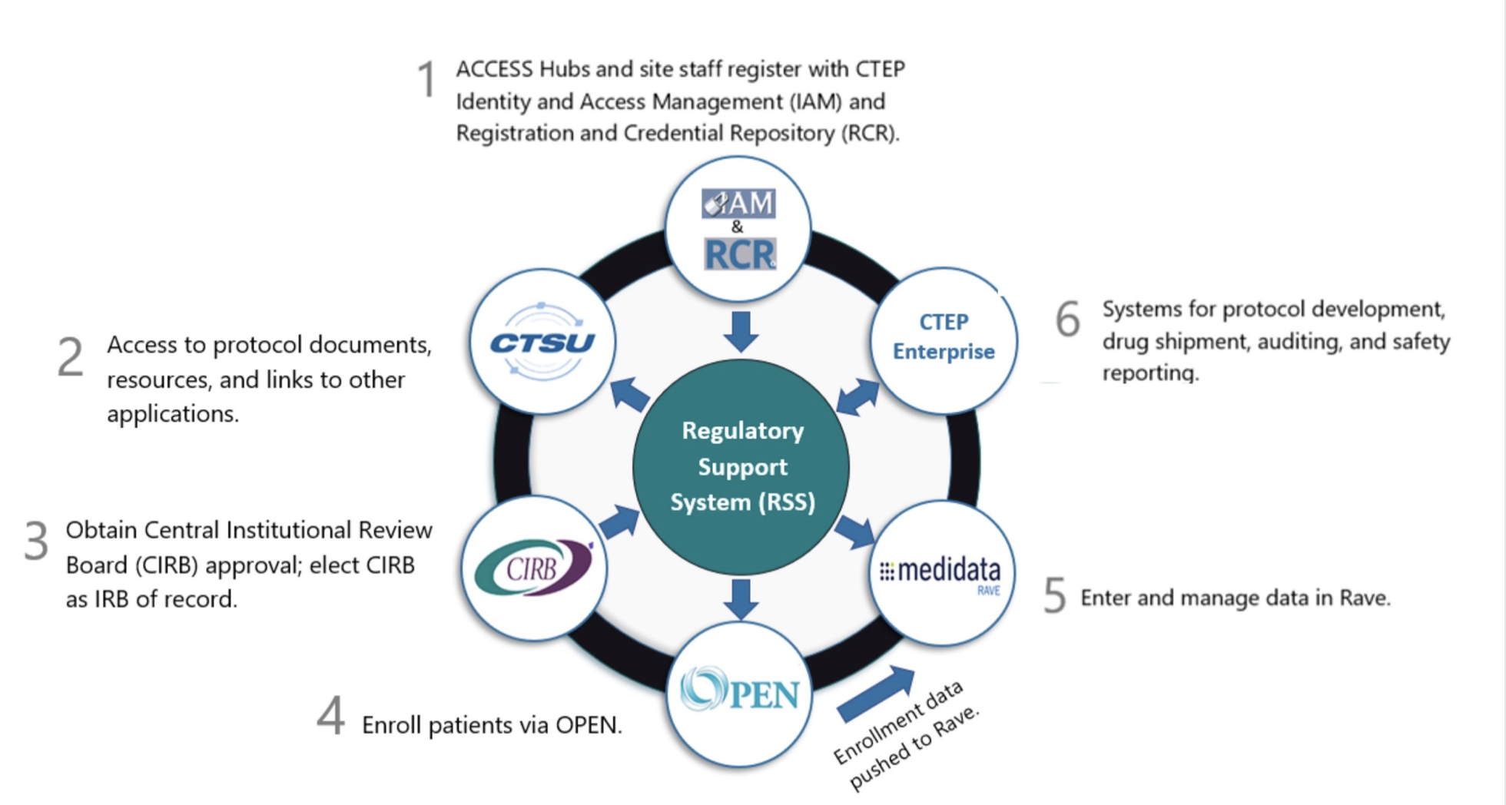
CSRN Will Use the NCI Clinical Research Infrastructure
https://prevention.cancer.gov/CSRN

Slide 8
Important information about the application
The Research Strategy is limited to 12 pages

Slide 9
Attachments
Attachment 1: Completed Multi-Site Clinical Studies and Trials. List all network/multi-center trials which this organization has coordinated and completed during the last 5 years. Projects conducted by or coordinated by the CCC applicant institution(s) as well as projects conducted by affiliated organizations should be included.
Attachment 2: Recruitment and Retention. Include a table of recruitment and retention statistics for trials completed within the last 5 years. Provide information regarding recruited participant demographics (including race and ethnicity) and accrual of underserved populations.
Attachment 3: Completed Clinical Trial Auditing Projects. List all clinical trial auditing projects completed during the last 5 years. Projects conducted by or coordinated by the CCC applicant institution(s) as well as projects conducted by affiliated organizations should be included.
Attachment 4: Auditing Policy. Provide the proposed auditing policy, including how patient cases are selected for auditing and how data is validated at the site and in associated clinical trial databases.

Slide 10
Research Plan

Slide 11
Research Plan for CCC
Experience:
Summarize the collective experience in successfully developing, organizing, and coordinating multi-center clinical trials and studies within the last 5 years
Communication:
Describe the communication process within the organizational structure. Explain the format for communication with committees and investigators
Describe the communication approach for the Network as a whole including the development of recruitment and retention strategies and workshops

Slide 12
Research Plan: Clinical Trials Development and Support
Describe the capability to develop, activate, conduct, and audit clinical studies in a timely manner
Describe past experience with, and approach to, investigator/institution rostering
Describe the capacity to provide infrastructure for the support and management of the steering committee and subcommittees/working groups
Describe the strategy for maintaining Network and study documents such as a manual of operations (guidelines), concepts, and protocols
Describe the strategy for oversight and coordination of study development, participant accrual, study conduct, and on-site or remote auditing for prior trials and how this would be adapted to support the CSRN
Highlight any unique approaches of the proposed CCC that reflect innovative ways of coordinating multi-center clinical trial research with an emphasis on screening trials
Describe procedures for data quality monitoring including query resolution

Slide 13
Research Plan: Use of Infrastructure and Collaboration
Describe the data management systems employed and prior experience with standard NCI tools including, but not limited to, Medidata Rave (experience with Medidata Rave not required)
Describe prior experience with a central IRB. Highlight any direct experience with the NCI CIRB
Describe established methods and procedures for biospecimen collection tracking; assessing case eligibility and evaluability in collaboration with the SDMC

Slide 14
Pilot or Feasibility Study
The Vanguard Study
The Vanguard study is a preliminary design
The protocol will require input from each CSRN component

Slide 15
The Vanguard Study
Pilot and feasibility study
Basic parameters of the Vanguard are described in each CSRN RFA (Research Plan, Section IV)

Slide 16
Preliminary Design for the Vanguard Study
The Vanguard study will randomize participants to one of 3 arms.
Each arm will contain approximately 8000 individuals
Arm 1 will be the control arm and participants allocated to Arm 1 will receive standard of care screening
Arms 2 and 3 will each receive a different MCD test annually for 2 years in addition to standard of care screening
Participants in MCD arms will undergo additional diagnostic tests based on a positive MCD result and the type of cancer that the MCD is intended to test for and/or identifies (for example if an MCD indicates the participant has a GI malignancy, they will undergo a GI malignancy workup)
It is anticipated that 1% of assay results will be positive and approximately 60% of positive results will reach a diagnostic resolution

Slide 17
CCC and the Vanguard Study
Describe the CCC's approach to this pilot study.
Include information regarding communication and collaboration with 10-15 ACCESS Hubs.
Please include a detailed description of participant recruitment and retention strategy.

Slide 18
Questions?

Slide 19
Thank you!
Please access https://prevention.cancer.gov/CSRN for up to date information and FAQs for the CSRN

Slide 20
NCI OUT Slate

