Slide 1
ULACNet Annual Meeting 2023
Gallery of Images

Slide 2
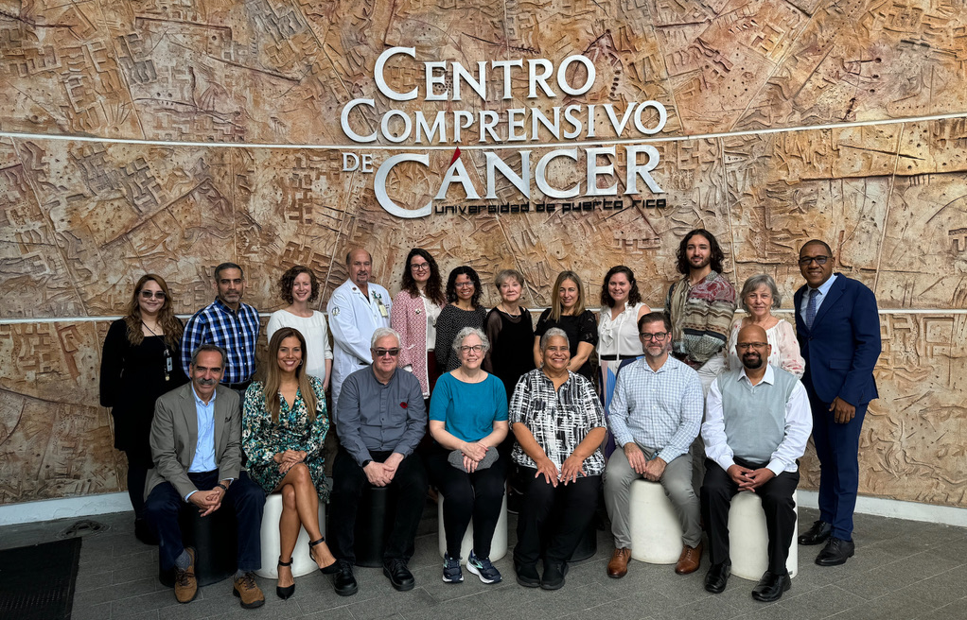
ULACNet Coordinating Committee

Slide 3
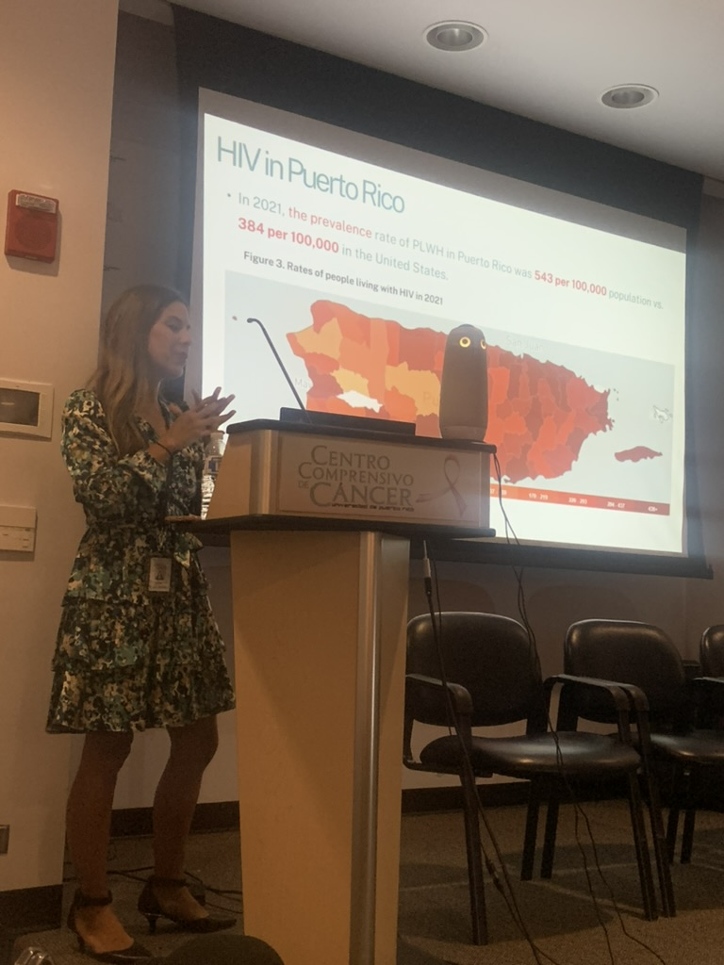
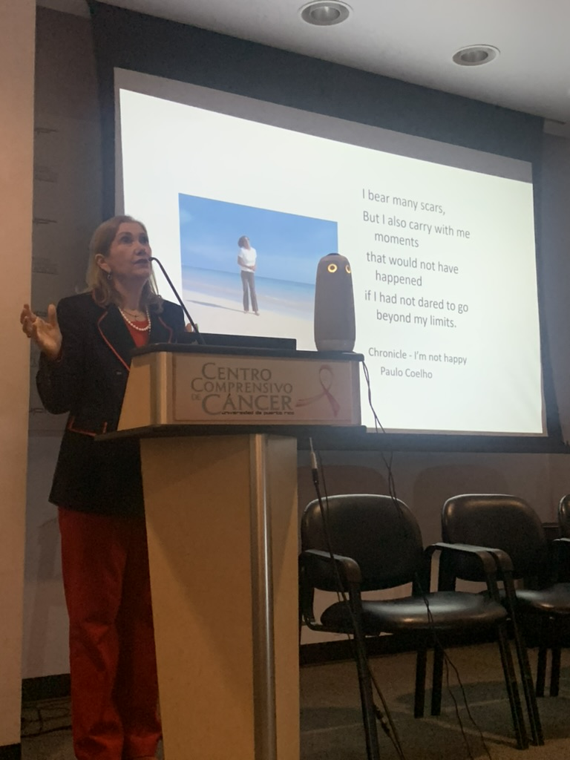
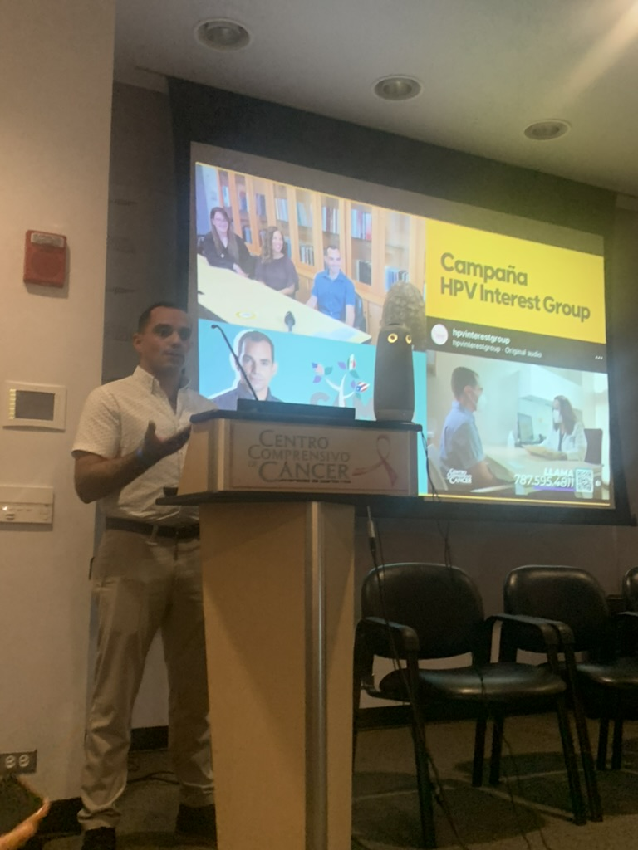
Session 1: Plenary Speakers
Ana Ortiz, PhD, MPH
UPR Comprehensive Cancer Center
Carmen Zorrilla, MD
University of Puerto Rico
Ronaldo Andres Vázquez Maldonado, BA
Department of Health Puerto Rico

Slide 4
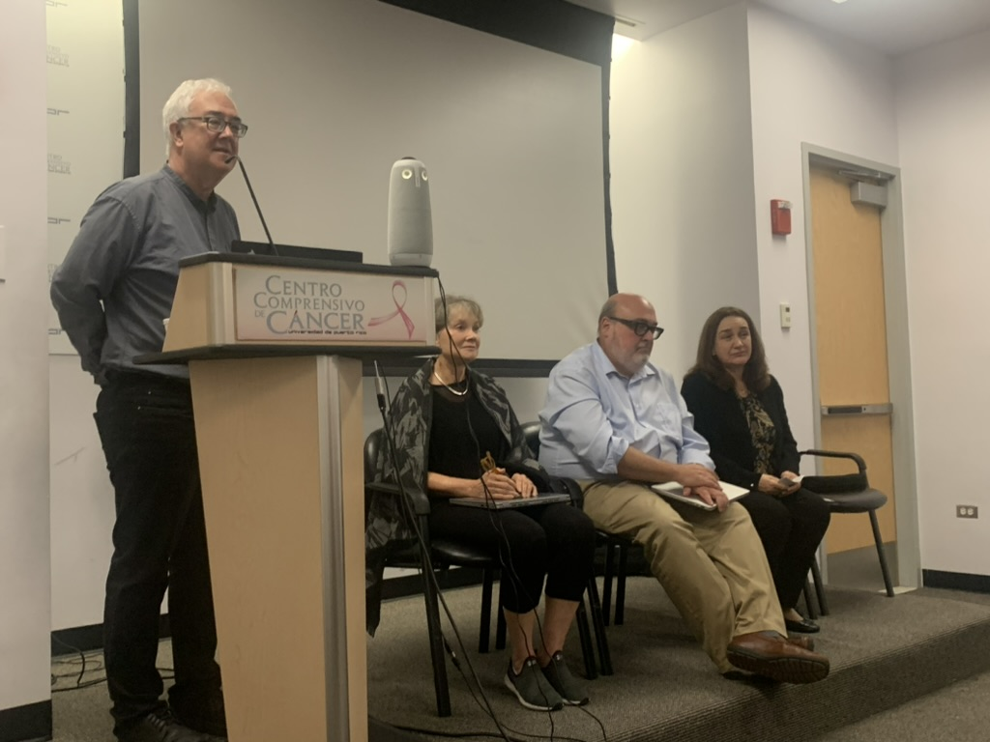
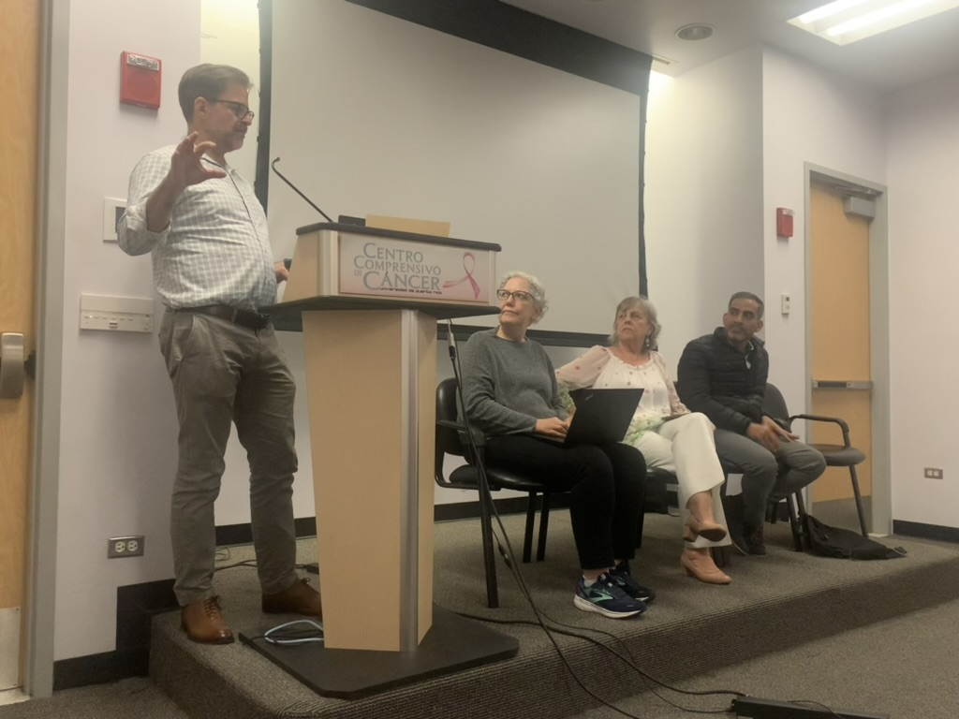
Session 2: Focus Area Panels
Prophylactic HPV Vaccines & Precancer Therapeutics
Moderator: Joel Palefsky, MD, University of California, San Francisco
Ann Duerr, MD, PhD, MPH, Fred Hutchinson
Rico Mark Einstein, MD, MS, Rutgers University
Josefina Romaguera, MD, MPH, University of Puerto
Lessons Learned from the Screening Trials of ULACNet: Where do we go from here?
Moderator: Tim Wilkin, MD, MPH, Weil Cornell Medicine
Margaret Madeleine, MPH, PhD, Fred Hutchinson
Luisa Villa, PhD, University of São Paulo
Salim Barquet, MD, MSc, PhD, Instituto Nacional de Cancerología

Slide 5
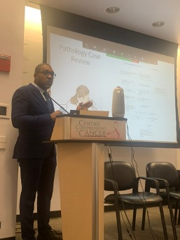
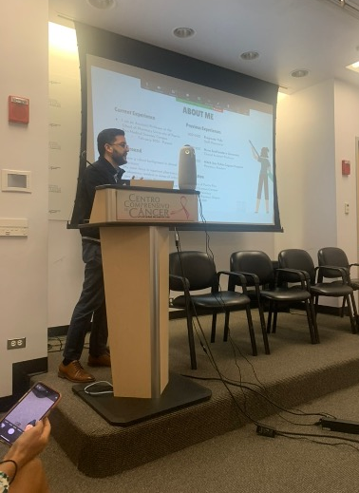
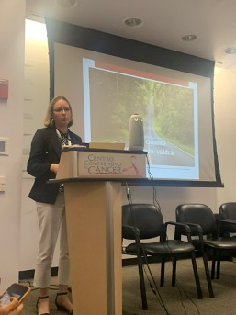
Session 3: Emerging Investigators in ULACNet
Arsimendy Benitez Abreu, MD
Instituto Dermatologico y Cirugia de Piel
Sayel Rivera-Garcia, PharmD, BCPS University of Puerto Rico
Marievelisse Soto Salgado, DrPH, MS University of Puerto Ric

Slide 6
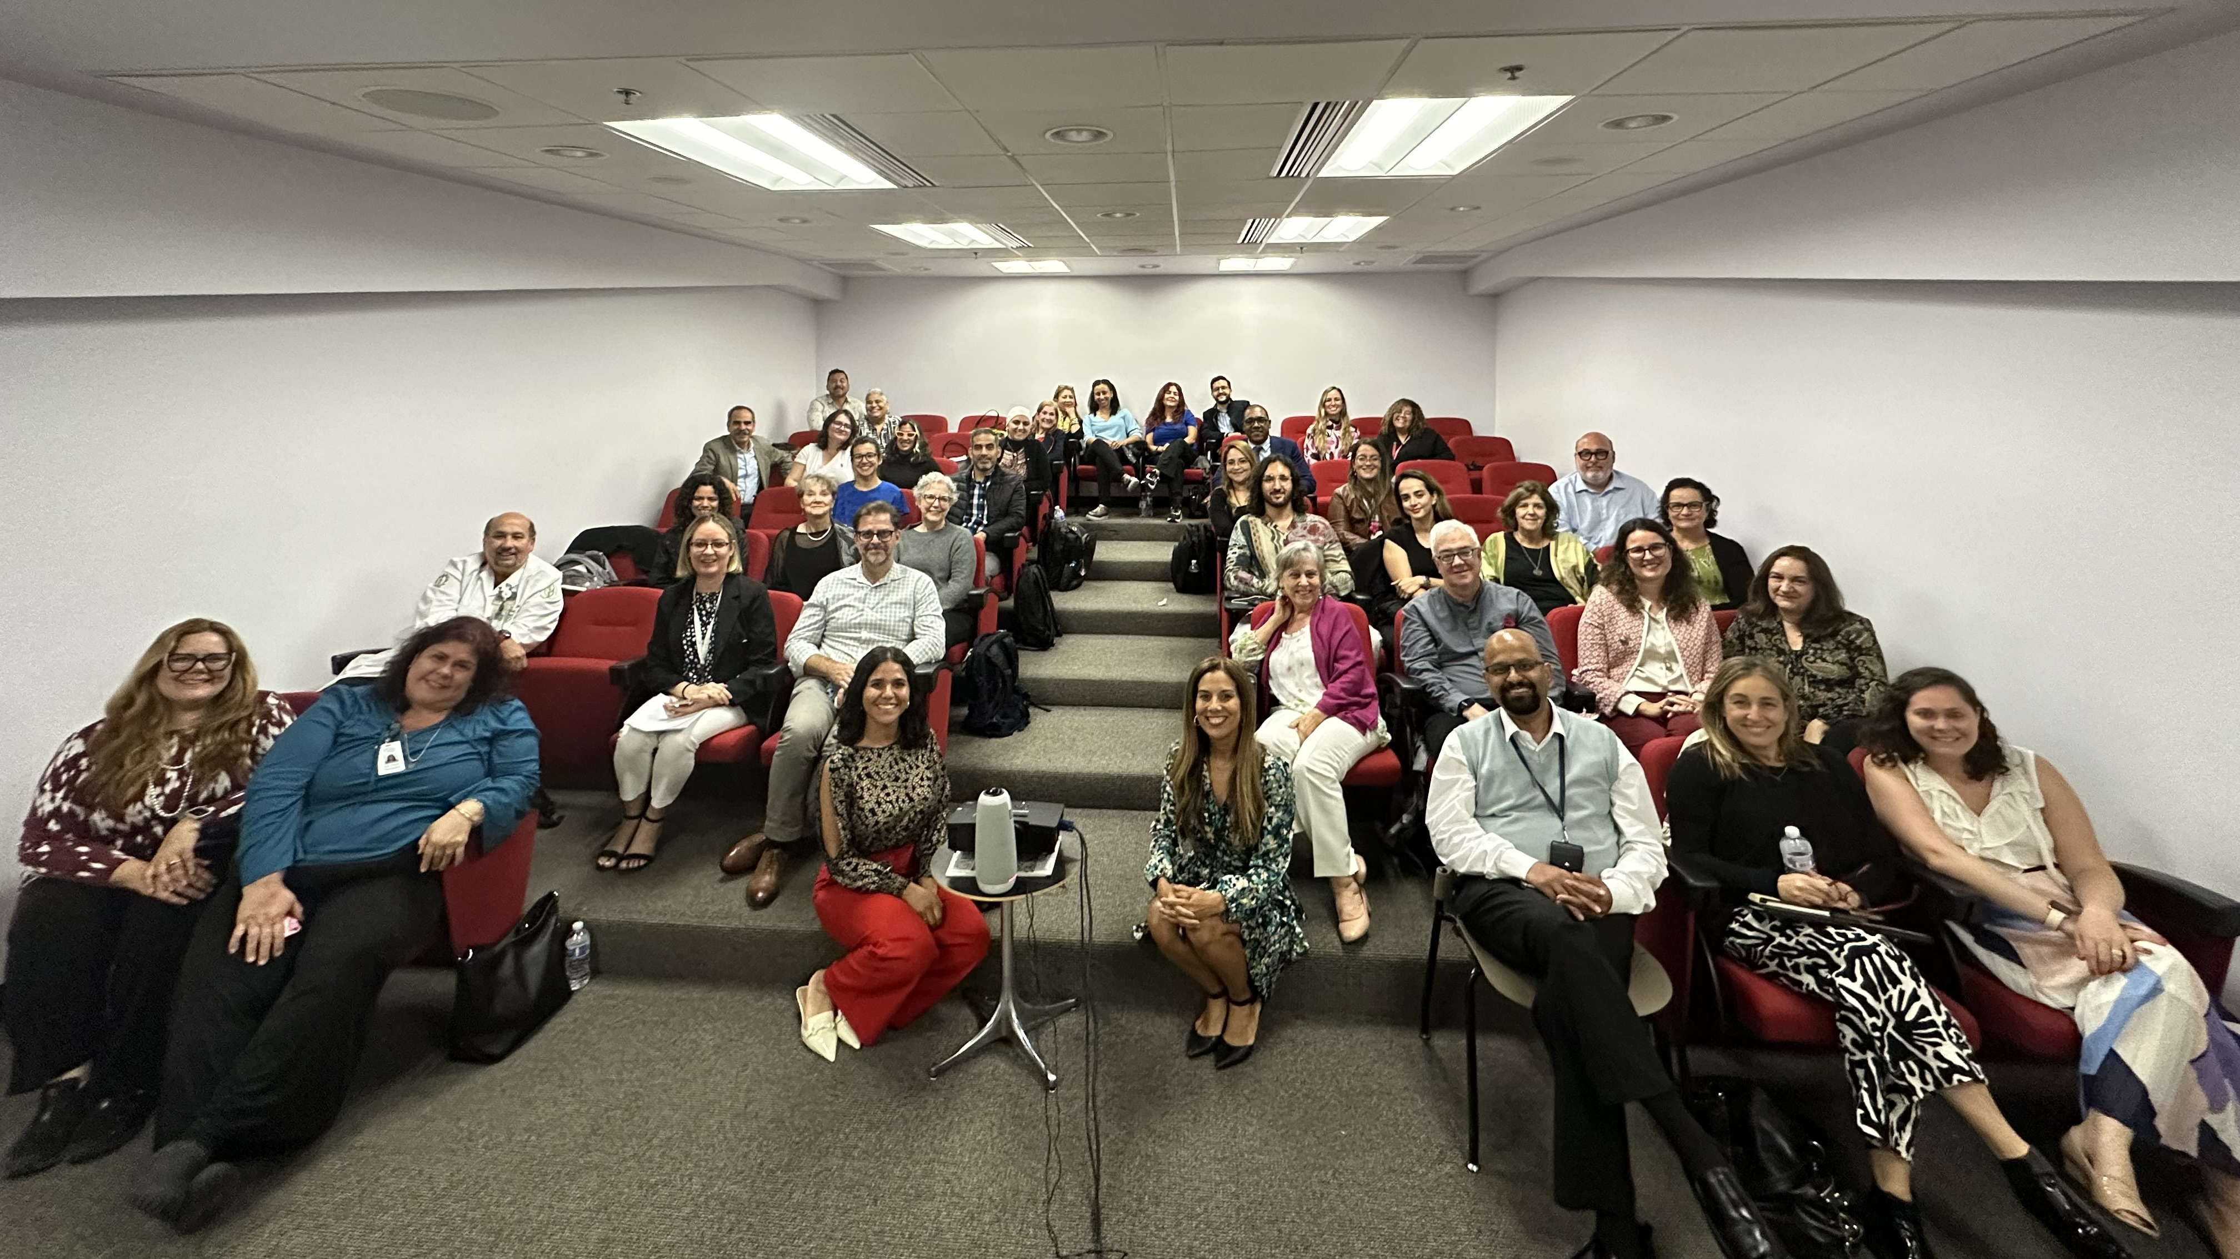
ULACNet Meeting In-Person Attendees

Slide 7
Thank you

