Slide 1


A Decade of NIH Cardio-Oncology Research Collaboration:
Continued Funding Opportunities
Bishow Adhikari PhD
Patrice Desvigne-Nickens, MD
Eileen Dimond BSN, MSN
Lori Minasian MD, FACP
Nonniekaye Shelburne CRNP, MS, AOCN®
Scarlet Shi, PhD
Denise Wiesch, MPH, PhD

Slide 2
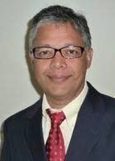
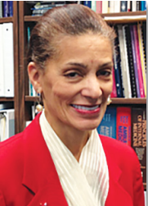
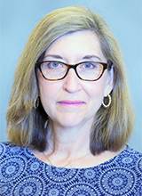
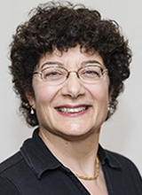
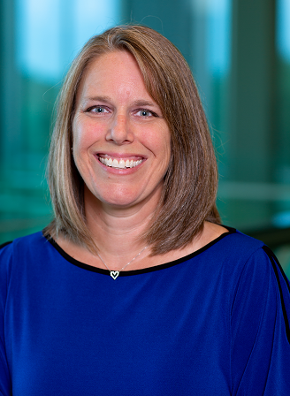
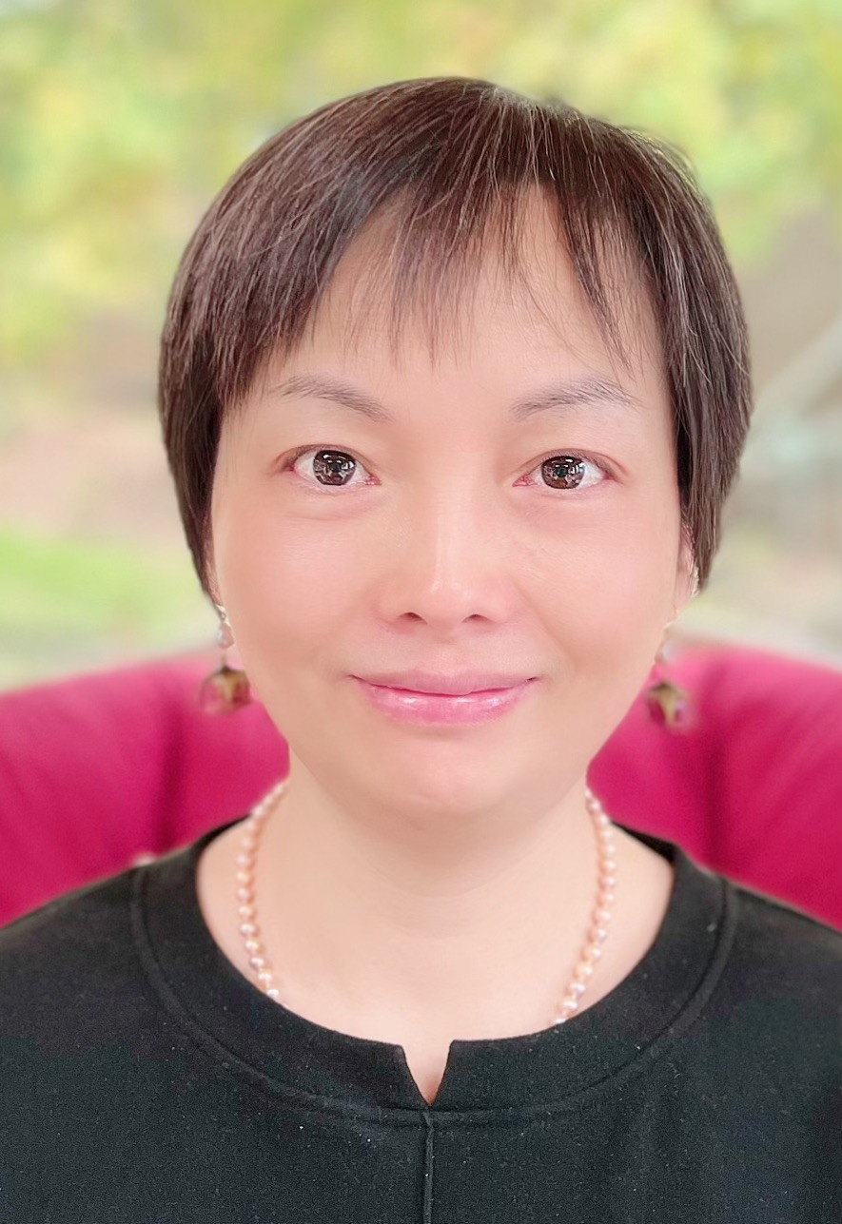
NIH Cardio-Oncology Team
Bishow Adhikari Ph.D.
NHLBI
Patrice Desvigne-Nickens M.D.
NHLBI
Eileen Dimond BSN, M.S.
NCI
Lori Minasian M.D.
NCI
Nonniekaye Shelburne C.R.N.P., M.S.
NCI
Scarlet Shi Ph.D.
NHLBI

Slide 3
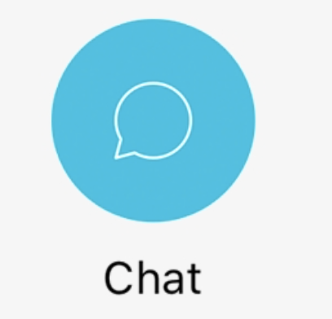
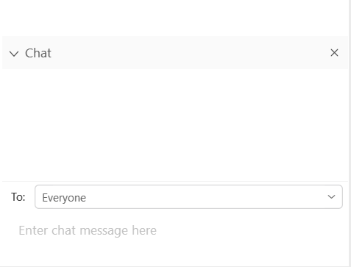
Using WebEx and Webinar Logistics
Submit questions at any time using the Chat Panel. Panelists will ask the question on your behalf during the Q&A session
All participant lines have been muted
This webinar is being recorded
The recordings will be available on NCI’s cardiotoxicity webpages in 2 weeks
  DCCPS https://epi.grants.cancer.gov/cardiotoxicity/
  DCP https://prevention.cancer.gov/major-programs/supportive-care-and-symptom-management/topic-areas/cardiotoxicity
Panelist
Enter questions here

Slide 4
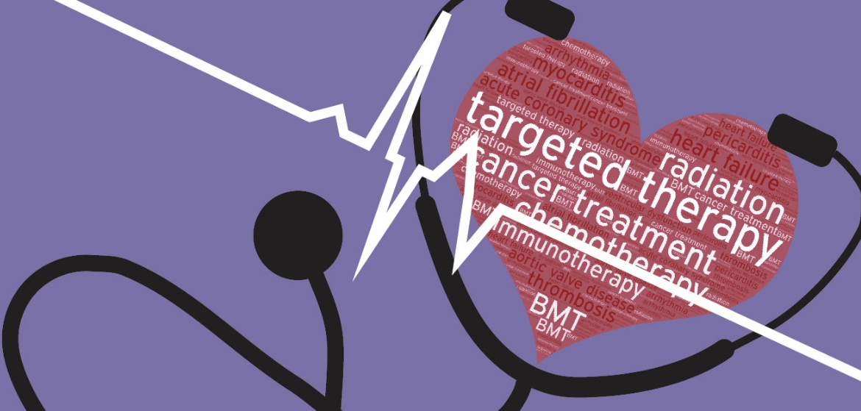
Agenda
The NIH Cardio-Oncology Initiative
Funding Opportunity Announcements
The NIH Peer Review Process
Q&A

Slide 5
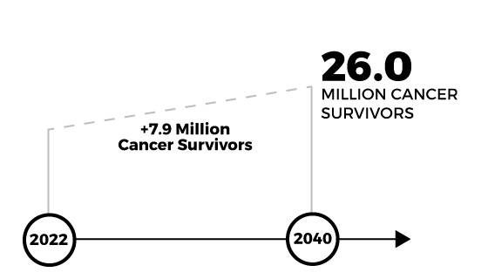
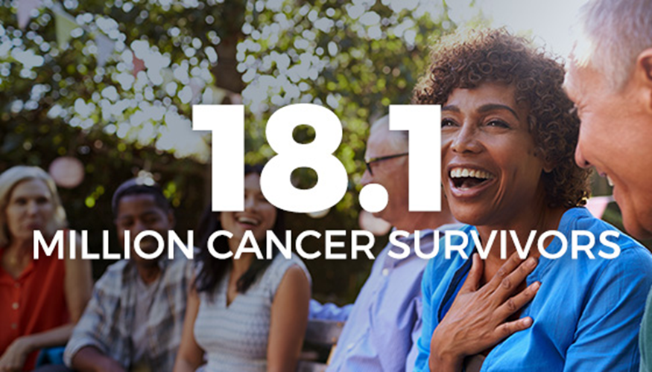
CV Toxicity from Cancer Treatments is a Significant Health Problem!
The number of cancer survivors is projected to increase to 26 million by 2040.¹
Longer survival has elevated concern for cardiovascular toxicity, especially as survivors age.
Graph is from https://cancercontrol.cancer.gov/ocs/statistics
¹American Cancer Society. Cancer Treatment & Survivorship Facts & Figures 2022-2024. Atlanta: American Cancer Society; 2022.

Slide 6
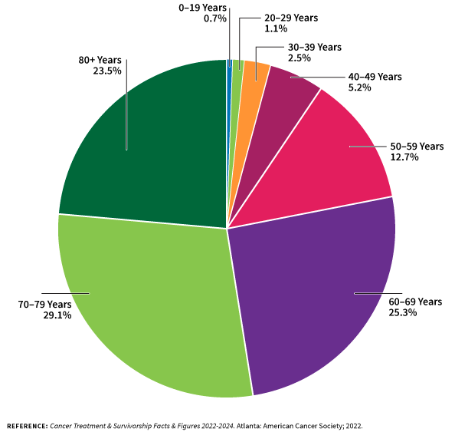
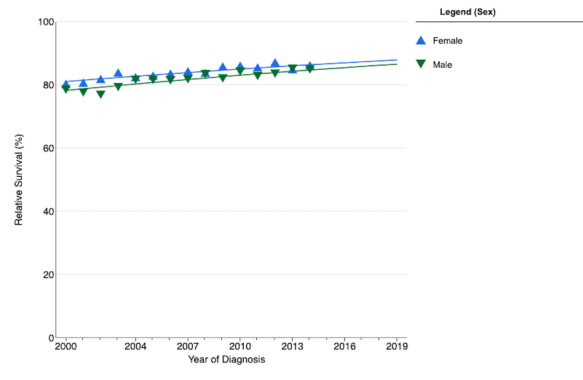
In Pediatrics as Well……
Cancer Survivors by Age (2022)
Pediatric Cancer Survivorship
5-year Relative Survival 85%
= > 500,000 survivors of childhood cancer
SEER data for ages 0-19 all sites by sex (2000-2018)

Slide 7
Understanding of CV Toxicity from Cancer Treatments is Incomplete
Cancer Treatment
CV Target
Timing
Cytotoxic Chemotherapy
Targeted Therapy
Immunomodulatory Agents
Radiation
Combination Therapy
Myocyte Dysfunction
Vascular Endothelium Injury
Valvular Damage
Hemodynamic Flow Alternations
Thrombotic Events
Acute
Chronic
Late-Onset
Patient Factors
Pre-existing CVD
Lifestyle Factors
Healthcare Access
Genetic Risk

Slide 8

Managing CV Toxicity from Cancer Treatments is a Balancing Act
Cardiovascular Risk Factors and Disease
Cancer Biology and Disease
Cancer Therapy
Risk of Cardiovascular Complications
Benefit of Cancer Therapy
Days/ Months
ACUTE
Balancing Risk vs. Benefit
Assess cardiovascular risk factors
Evaluate cancer therapy impact
Implement cardioprotective interventions
CHRONIC
Years
LATE-ONSET
Decades
This article was published in Translation Research in Cardio-Oncology, 18, Adhikari et al.,
Spectrum of National Institutes of Health-Funded Research in Cardio-Oncology: Basic, Clinical, and Observational Science Perspective, 515-528, Copyright Elsevier 2022.

Slide 9
Where have we been?
Identifying & Addressing Knowledge Gaps
1st Workshop
March 2013
White
Paper
Task Force
2nd Workshop
June 2018
White Paper
10-year Portfolio Funding Paper
Funding Opportunity Announcements (FOAs)
(2015-2022)
Current NOSI
(2022-2024)
Recommendation Category | JNCI 2014: 106(8) | Curr Oncol Rep 2019: 21(9)
Developing Standards | LVEF reduction of 10% to less than 50%; or >15% from baseline | Utilize natural language processing to enhance data capture
Mechanisms of Damage | Characterize signaling pathways | Broaden use of human induced pluripotent stem cells (cardiomyocyte, endothelial)
Preclinical and Animal Studies | Utilize models with cardiac stressors | Move mechanistic evidence into preclinical models and validation criteria
Markers of Risk & Injury | Incorporate imaging and biomarkers into risk stratification tools | Implement core lab processing
Prevention & Management | Cardiac meds, activity, diet…When, what, how much and to whom? | Focus on modifiable risk factors
Cancer Survivorship | Longitudinal follow-up; care coordination | Risk stratification tools that inform health system resource utilization

Slide 10
NIH Research Support Over the Past 12-year Period
What has been NIH support like for cardio-oncology research projects?
Conducted a keyword search of the NIH Grant Database over a 12-yr period (2011-2022)
Captured all projects (i.e., investigator-initiated and in response to the FOAs)
Reviewed to ensure research aims addressed cancer treatment and cardiotoxicity

Slide 11
Spectrum of NIH Research Support in Cardio-Oncology (years 2011-2022)
By research categories (n=143)
Observational
N=37, 26%
Clinical Trials &
Interventions
N=14, 10%
Basic & Translational
N=92, 64%
This article was published in Translation Research in Cardio-Oncology, 18, Adhikari et al.,
Spectrum of National Institutes of Health-Funded Research in Cardio-Oncology: Basic, Clinical, and Observational Science Perspective, 515-528, Copyright Elsevier 2022.

Slide 12
Spectrum of NIH Research Support in Cardio-Oncology (2011-2022)
143 research projects, ~ $147M
Research Project Grants
Training & Fellowships
SBIR/STTR
Other
All costs are Biomedical Research and Development Price Index (BRDPI) adjusted.
This article was published in Translation Research in Cardio-Oncology, 18, Adhikari et al.,
Spectrum of National Institutes of Health-Funded Research in Cardio-Oncology: Basic, Clinical, and Observational Science Perspective, 515-528, Copyright Elsevier 2022.

Slide 13
Overall Trend of NIH Research Support in Cardio-Oncology (years 2011-2022)
Cardiotoxicity FOAs
NOSI
White Paper
2013
Workshop
Task Force Initiated
2018
Workshop
White Paper
Fiscal Year
BRDPI adjusted
This article was published in Translation Research in Cardio-Oncology, 18, Adhikari et al.,
Spectrum of National Institutes of Health-Funded Research in Cardio-Oncology: Basic, Clinical, and Observational Science Perspective, 515-528, Copyright Elsevier 2022.

Slide 14
Examples of Impact of the NIH Initiatives
Cardiotoxicity Program Announcements (2015-22)
  NCI and NHLBI supported 34 research projects (~$33M)
  Smaller projects (R21/R03) led to subsequent larger projects (R01)
  Supported early-career scientists (4 Early Stage and 5 New Investigators)
Funding of clinical trials through grants and networks
NOSI submission reviews are still in-progress (2022-24)
Collaboration efforts on standardizing definitions and outcome measures

Slide 15
Cardio-Oncology Funding Across the Cancer Continuum
Basic & Translational Studies
Clinical Trials & Interventional Studies
Observational Studies
Mechanisms of cardiovascular injury
Signaling pathways
Cardiotoxicity models, risk biomarkers, and injury probes
Novel therapeutic agents to reduce toxicity
Testing cardiac-sparing cancer therapy
Testing cardioprotective interventions
Cardiovascular risk assessment
Detection of subclinical cardiovascular injury
Identifying cardioprotective measures
Adhikari et al., 2022

Slide 16
NIH Grant Mechanisms Supporting Cardiotoxicity Research
Cancer Treatment Related Cardiotoxicity
NOT-CA-22-001
Cancer Treatment Adverse Events
Adverse Sequelae
NOT-CA-22-005 P01
Healthcare Delivery
Risk Stratification NOT-CA-21-019
Telehealth NOT-CA-21-043
Accelerated Aging NOT-CA-21-031
PAR-21-329 R01
Study
Design
R01
R03
R21
P01
Pragmatic Trials
Implementation Science
R34 CT Planning Grant

Slide 17
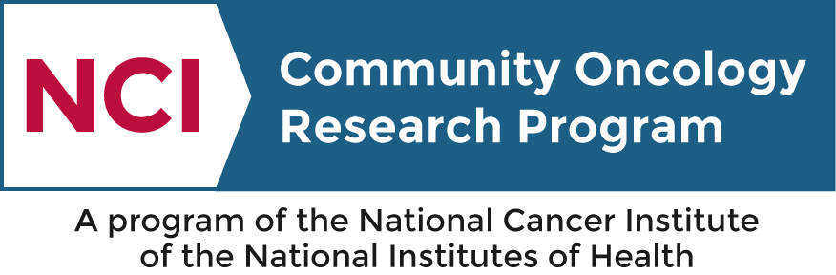


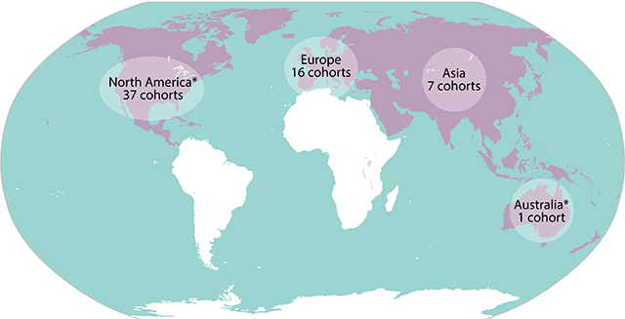
NIH Infrastructure Supporting Cardiotoxicity Research
Children/AYAs
Adults with cancer
and survivors
NCTN
Groups & Research Bases
NCORP
Cancer Epidemiology Cohorts

Slide 18
Examples of Research Infrastructure Support
Study Title | Design | Population | PI | Infrastructure support
Cancer Therapy Risk-Reduction with Intensive Systolic BP Management (CARISMA) - a Phase II Study NCT04467021 | Intervention: Phase II Intense BP control | Adults with metastatic renal/thyroid cancers receiving anti-angiogenic tyrosine kinase inhibitors | Bonnie Ky | NCORP – ECOG-ACRIN
Preventing Anthracycline Cardiovascular Toxicity with Statins (PREVENT) NCT01988571 | Intervention: Atorvastatin vs Placebo | Women receiving anthracycline-based chemotherapy for triple negative breast cancer | Greg Hundley | NCORP – Wake Forest Research Base R01 Grant
Effects of Dexrazoxane (DCZ) HCL on Biomarkers Associated With Cardiomyopathy and HF After Cancer Treatment NCT01790152 | Observation: Biomarkers, ECHO, 6 min walk | Previously treated Leuk/Lymph/ Osteosarcoma survivors who did/did not receive DRZ | Eric Chow, Steve Lipshultz | NCORP-COG R01 Grant
St Jude Life | Longitudinal | CCS | Melissa Hudson | U01 Grant

Slide 19
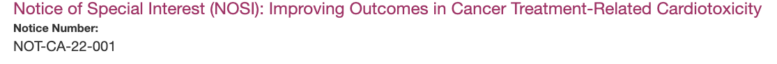
Moving Forward with
NOT-CA-22-001
Purpose: to encourage collaborative and innovative approaches to mitigate cardiovascular dysfunction while optimizing cancer outcomes by understanding the mechanisms of cancer treatment-related cardiotoxicity and translating the findings to improve risk stratification, early detection, prevention, and management
How does this NOSI work? This NOSI identifies cancer-treatment related cardiotoxicity as an area of scientific interest for NHLBI and NCI. It directs applicants to multiple funding announcements (FOAs) which they can submit applications on cardiotoxicity.

Slide 20
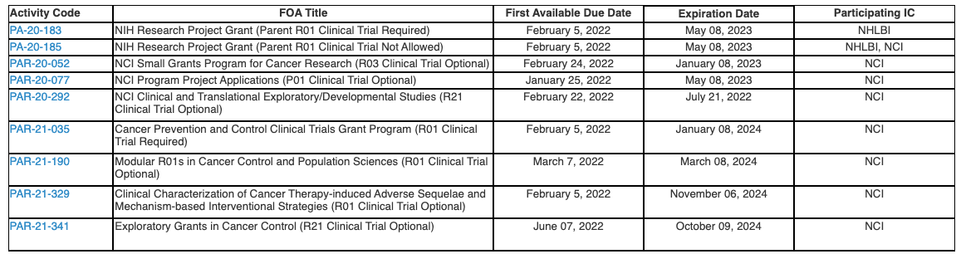
NOSI Submission Tips
STEP 1: Submit under the appropriate FOA via the SF424 form (standard application).
STEP 2: Enter NOT-CA-22-001 in Box 4B, Agency Routing Identifier.

Slide 21

Role of Program Directors/Officials (PD/PO)
Identify next funding opportunities
Explain different grant mechanisms
Interpret NIH submission policies and procedures
Discuss how to frame your research so it fits with NIH strategic priorities
Identify appropriate study sections and reviewer expertise
Discuss summary statements and approaches to resubmission
Serve as a scientific sounding board

Slide 22
Summary
Improvements in cancer treatments and survival are impacted by the incidence of cardiotoxicity
Survey of the past decade shows that NIH research support on treatment-related cardiotoxicity has been robust and increasing
NIH is supporting a broad range of basic/translational, clinical/interventional, and observational studies across the cardio-oncology patient population
There are remaining gaps and opportunities for research to improve the lives of cancer survivors but remain at significant risk for a multitude of treatment effects
NIH Program Officers are here to help with the grant process from idea generation and fit to grant award and beyond!

Slide 23
The NIH Cardiotoxicity Team is Here to Help!
Contact our Team with your questions!
NCI
NHLBI
Nonniekaye Shelburne, DCCPS Nonniekaye.Shelburne@nih.gov
Eileen Dimond, DCP Eileen.Dimond@nih.gov
Lori Minasian, DCP Lori.Minasian@nih.gov
Patrice Desvigne-Nickets, DVCS patrice.desvigne-nickens@nih.gov
Bishow Adhikari, DVCS bishow.adhikari@nih.gov
Scarlet Shi, DVCS scarlet.shi@nih.gov

