Slide 1
The NIH Peer Review Process
Denise Wiesch, Ph.D., M.P.H
Ramona Gianina Dumitrescu, Ph.D., M.P.H. (CHD)
Mohammed Elfaramawi M.D, Ph.D., M.P.H. (CRD)
Scientific Review Officer
Cancer and Hematologic Disorders (CHD) Study Section
Epidemiology and Population Health (EPH) Branch
Division of AIDS, Behavioral and Population Sciences
Center for Scientific Review, NIH

Slide 2
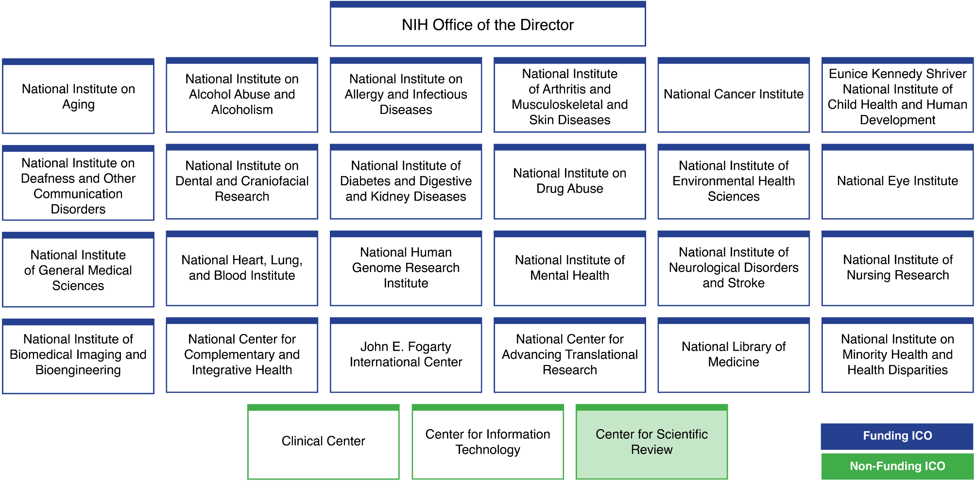
National Institutes of Health

Slide 3
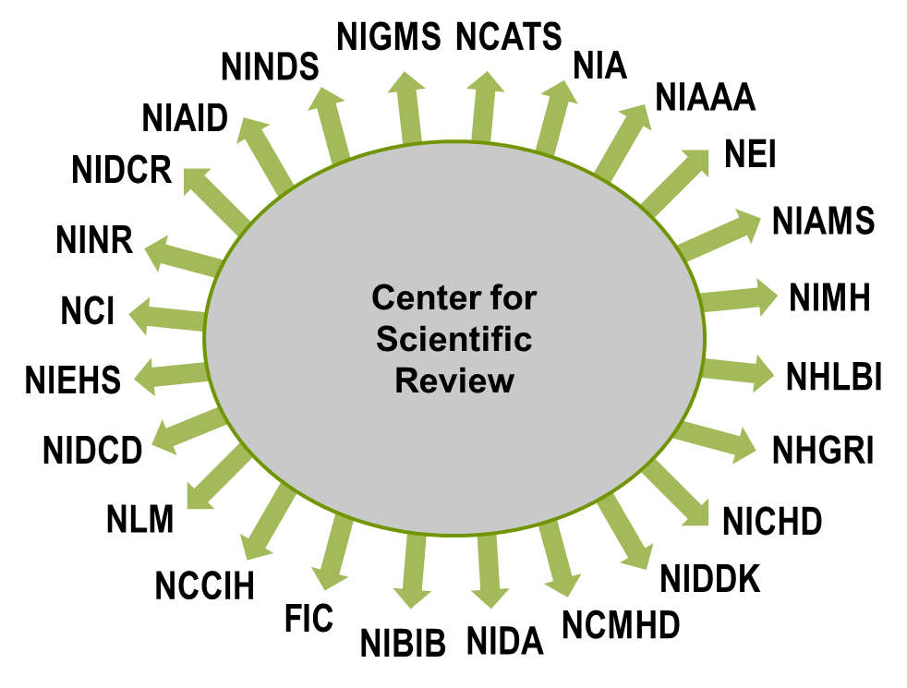
24 NIH Institutes and Centers Fund Grants

Slide 4
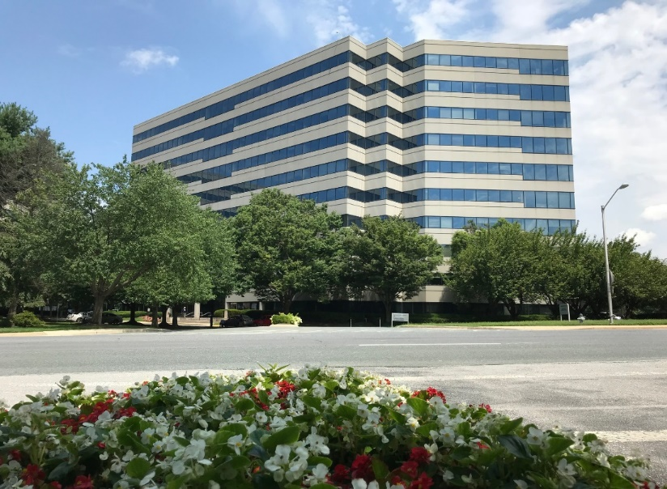
Role of CSR:
Receipt & Referral, Review
The Center for Scientific Review (CSR) receives all NIH grant applications
Refers applications to CSR or NIH institute scientific review groups for review of scientific merit
Refers applications to one or more NIH institutes or centers (IC) for funding
Administers the review of scientific merit of most NIH research applications
    Study section in CSR review 76% of all NIH grant applications = ~61,000 applications a year
CSR study sections are not IC specific

Slide 5

CSR’s Division of Receipt and Referral
Determines if your application is
On time
Formatted correctly
Complete
Compliant with NIH policy
Assigns your application to
Institute(s) or center for funding consideration
Review group for review of scientific and technical merit
If you have questions during these stages, please reach out to DRR:
csrdrr@mail.nih.gov

Slide 6
Applications Are Assigned to:
Institutes or Centers based on
    Overall mission and guidelines of the IC (Institute/Center)
    Specific programmatic mandates and interests of the IC
    Applications can only be assigned to ICs participating in the FOA
Scientific review groups based on
    Specific, published review guidelines for each review group
    Suggestions made in the Assignment Request Form are considered
  Referral Process:
    DRR Referral Officers Branch Chiefs SROs Applicant

Slide 7
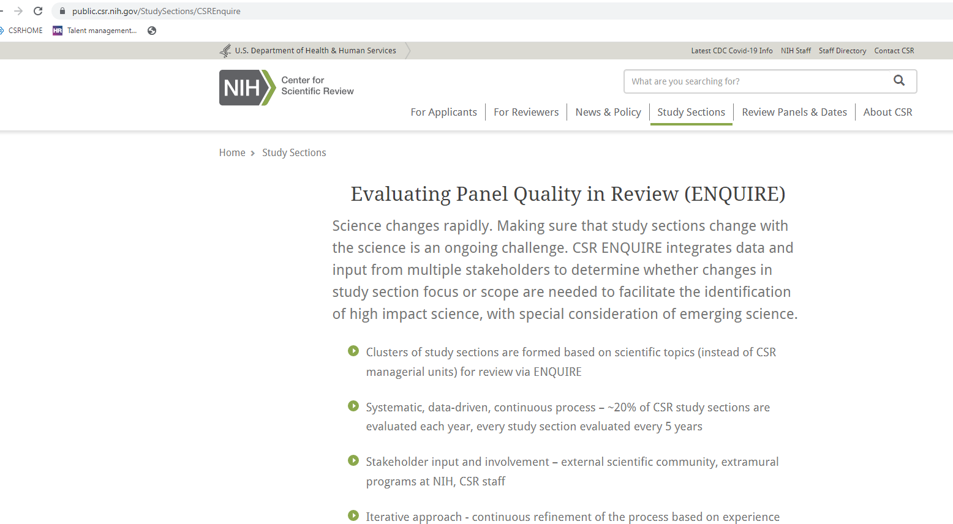
ENQUIRE: Overview and details
https://public.csr.nih.gov/StudySections/CSREnquire

Slide 8
Epidemiology and Population Health scientific review groups ended after summer 2022 review meetings
Behavioral Genetics and Epidemiology (BGES)
Biostatistical Methods and Research Design (BMRD)
Cancer, Heart, and Sleep Epidemiology Panel A (CHSA)
Cancer, Heart, and Sleep Epidemiology Panel B (CHSB)
Clinical Research & Field Studies of Infectious Disease* (CRFS)
Infectious Diseases, Reproductive Health, Asthma and Pulmonary Conditions* (IRAP)
Kidney, Nutrition, Obesity, and Diabetes (KNOD)
Neurological, Aging and Musculoskeletal Epidemiology* (NAME)
(*and overflow SEPs)
Revised scope after 2022 review meetings:
Genetics of Health and Disease (GHD)

Slide 9
New Epidemiology and Population Health Branch
Conceptual Framework
Health States
Data/Methods
Exposure
Aging, Injury, Musculoskeletal, and Rheumatologic Disorders (AIMR)
Reproductive, Perinatal, and Pediatric Health (RPPH)
Population-based Research in Infectious Disease (PRID)
Cancer and Hematological Disorders (CHD)
Cardiovascular and Respiratory Diseases (CRD)
Kidney, Endocrine, and Digestive Disorders (KEDD)
Neurological, Mental, and Behavioral Health (NMBH)
Lifestyle and Health Behaviors (LHB)
Social and Environmental Determinants of Health (SEDH)
Analytics and Statistics for Population Research panel A (ASPA)
Analytics and Statistics for Population Research panel B (ASPB)

Slide 10
CHD study section scope and topics
Scope: reviews applications that seek to understand the etiology, determinants, distribution and outcomes of cancer and hematologic disorders, conditions and phenotypes from a population health perspective.
Topics:
    Incidence, prevalence, progression and consequences of cancers in large populations including the focus on early detection, survivorship and recurrence
    Incidence, prevalence, progression and consequences of hematologic disease and phenotypes in large populations, including but not limited to anemias, disorders of coagulation, lymphomas and leukemias
    Effects of environmental and other exposures on incidence, progression, and outcomes related to cancer and hematologic disorders in large populations
    Incidence, prevalence and determinants of co-morbidities and multi-morbidities in populations with cancer and hematological disorders

Slide 11
CRD study section scope and topics
Scope: reviews applications that seek to understand the etiology, determinants, distribution and outcomes of cardiovascular and respiratory phenotypes, disorders and diseases from a population health perspective.
Topics:
    Incidence, prevalence, progression and consequences of cardiovascular and disorders in large populations that include but are not limited to heart failure, atherosclerosis, pulmonary vascular disease and myocardial infarction
    Incidence, prevalence, progression and consequences of respiratory diseases and disorders in large populations that include but are not limited to chronic obstructive pulmonary disease (COPD), asthma, and bronchopulmonary dysplasia
    Effects of environmental and other exposures on incidence, progression, and outcomes related to cardiovascular and respiratory health in large populations, especially with a focus on the disease or disorder outcome rather than the exposure
    Incidence, prevalence and determinants of co-morbidities and multi-morbidities in populations with cardiovascular and respiratory diseases

Slide 12
Examples of study sections of shared interest with CHD
Effect of Social, Environmental and Health Behaviors on Cancer and Hematological Disorders
Social and Environmental Determinants of Health – SEDH
Clinical research of Hematological Disorders and Cancer
Ethnic and racial disparities in cancer outcomes
Basic Mechanisms in Cancer Health Disparities – BMCD
Clinical Integrative Cardiovascular and Hematological Sciences – CCHS
Genetic predisposition to cancer and hematological disorders
Cancer Genetics Study Section – CG
Lifestyle and Health Behaviors – LHB
Molecular Cancer Diagnosis and Classification – MCDC
Analytics and Statistics for Population Research Panel A – ASPA
Clinical Oncology Study Section – CONC
Cardiovascular and Respiratory Diseases – CRD (epi)
CHD

Slide 13
Study Sections that have typically reviewed
Cancer-related Cardiotoxicity applications:
Retired Study Sections | Now Covered by…
CHSA CHSB | Cancer and Hematologic Disorders (CHD) Cardiovascular and Respiratory Disorders (CRD)
CICS CCHF | Clinical Integrative Cardiovascular and Hematologic Sciences (CCHS)
MIM | Integrative Myocardial Physiology / Pathophysiology A / B (MPPA and MPPB)
HSOD NRCS | Health Services Quality and Effectiveness (HSQE) Organization and Delivery of Health Services (ODHS) Clinical Management in General Care Settings (CMGC) Interdisciplinary Clinical Care in Specialty Care Settings (ICSC)
DT | Advanced Therapeutics (ATA)
RTB | Radiation Therapeutics and Biology (RTB)
https://public.csr.nih.gov/StudySections

Slide 14
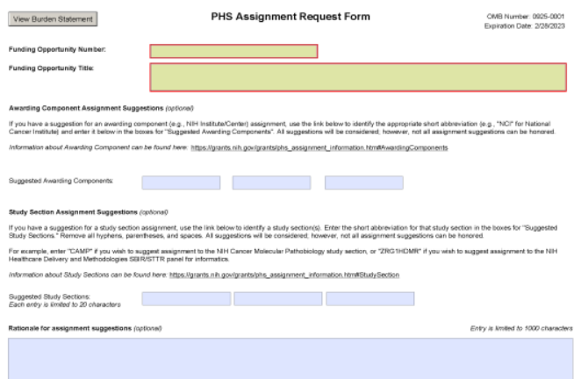
Assignment Request Form (ARF)
Not required
Suggest assignments (study section and institute)
Identify potential conflicts of interest
List areas of expertise needed to evaluate the application
Speak freely! This form will not be part of the assembled application; it will not be made available to program or to reviewers.

Slide 15
Who Can Answer Your Questions?
Before you submit your application
A program officer (PO) at an NIH Institute or Center
Scientific review officer (SRO)
CSR Division of Receipt and Referral (csrdrr@mail.nih.gov)
After you submit
Your SRO
CSR Division of Receipt and Referral (csrdrr@mail.nih.gov)
After your review
Your assigned PO
Grants Info: GrantsInfo@od.nih.gov – 301 945-7573

Slide 16
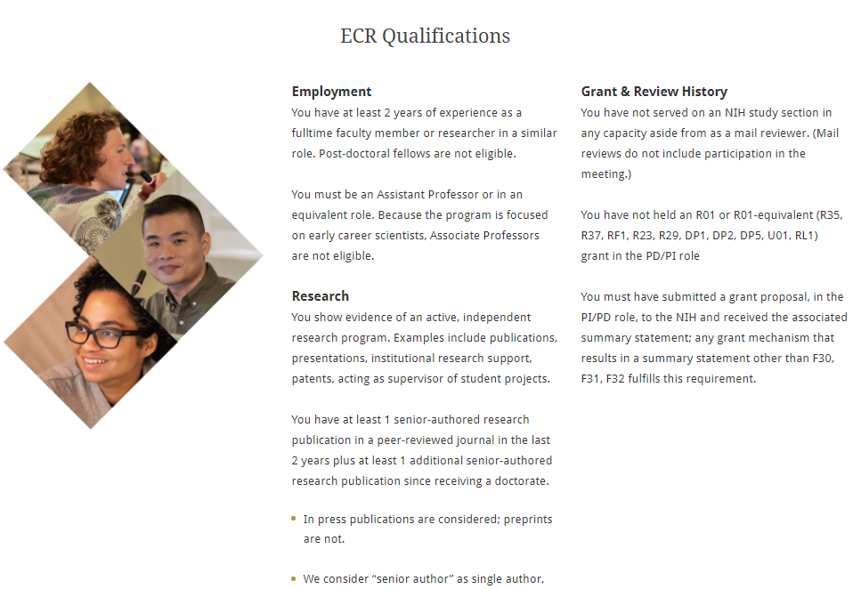
Serve on a Review Panel
Established Investigators can serve as Ad Hoc or Regular Members – say yes when invited!
Early career scientists can enroll in CSR’s early career reviewer (ECR) program.
ECR’s serve one time and review 2 applications as Reviewere#3.
For ECR qualifications and application process. https://public.csr.nih.gov/ForReviewers/BecomeAReviewer/ECR
Aimed at early career, independent scientists – postdocs are not eligible and tenured professors are not eligible
Review experience and successful competition for an R01 or equivalent are disqualifiers.

Slide 17

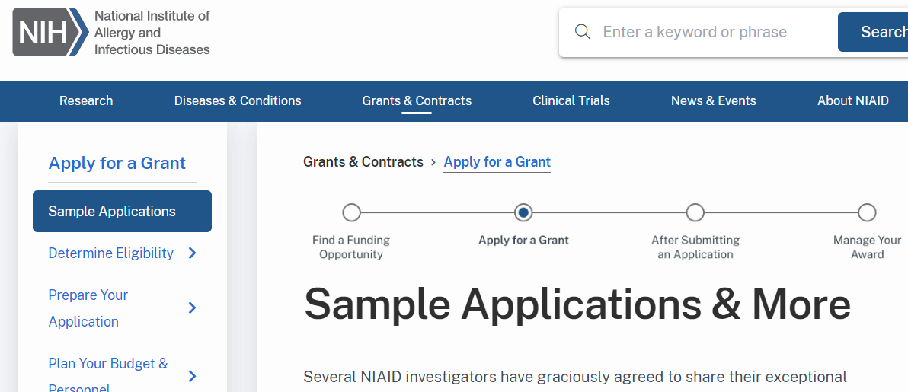
Other Resources
Webinars - Early Career Reviewer Panel Q & A and Grants 101 - https://public.csr.nih.gov/NewsAndPolicy/PeerReviewVideos
Sample applications at https://www.niaid.nih.gov/grants-contracts/sample-applications

Slide 18
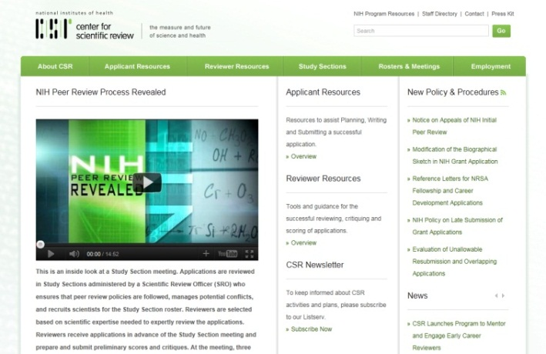
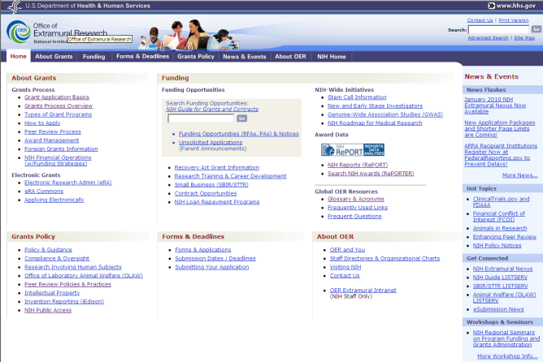
Key NIH Review and Grants Web Sites
NIH Center for Scientific Review
http://www.csr.nih.gov
NIH Office of Extramural Research
http://grants.nih.gov/

