Slide 1
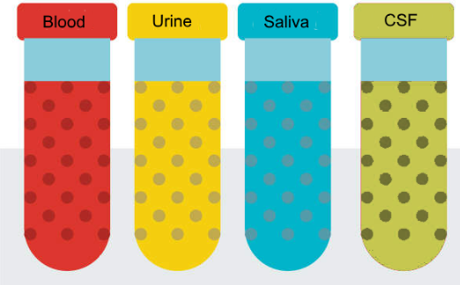
National Cancer Institute Symposium on Charting the Course of Liquid Biopsy in Precision Prevention and Treatment
December 15-16, 2021
Johns Hopkins
MGH
MGH
Washington U
UCLA
Yale

Slide 2
Lung Cancer Screening via Ultrasensitive Analysis of Tumor DNA Signatures in Blood
NCI Liquid Biopsy Consortium Steering Committee Virtual Meeting
February 24, 2021
Abhijit Patel, MD, PhD
Associate Professor, Department of Therapeutic Radiology

Slide 3
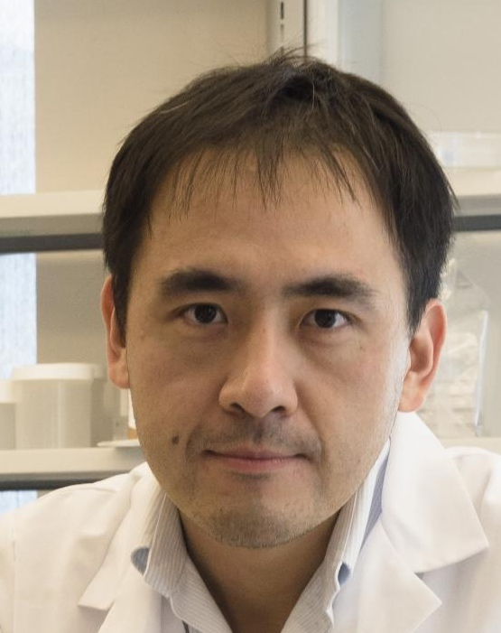
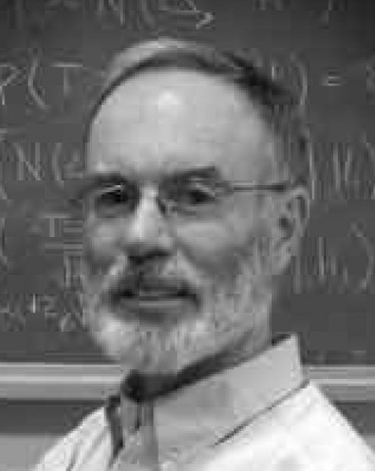
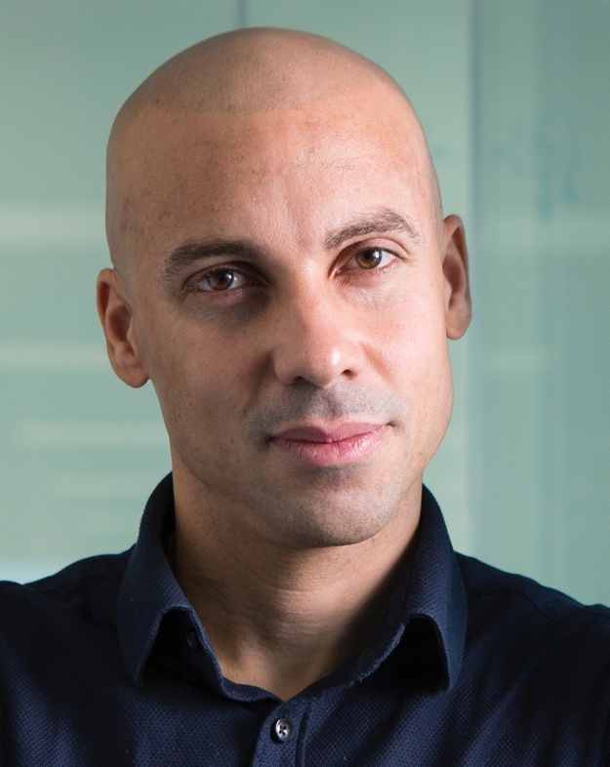
NCI Liquid Biopsy Consortium Team
David Zhang, PhD
Nucleic acid biophysics
Machine learning
Steven Skates, PhD
Biostatistics
Early Detection
Daniel Boffa, MD
Thoracic Surgery
CTCs / ctDNA
Andrew Phillips, PhD
Machine Learning
Neural Networks

Slide 4
Probing Mutations and Epigenetic Features
Mutations
Epigenetic Features
Few mutations per genome
Epigenetic signatures are found throughout the genome.
Can reduce plasma volume!

Slide 5
Thank You!
Johns Hopkins
MGH
MGH
Washington U
UCLA
Yale

