Slide 1
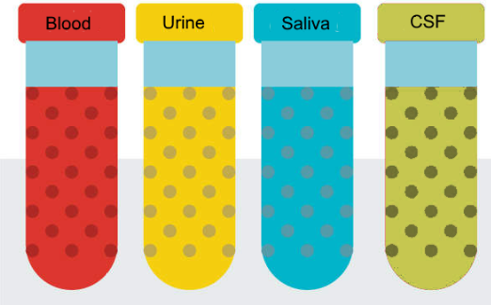
National Cancer Institute Symposium on Charting the Course of Liquid Biopsy in Precision Prevention and Treatment
December 15-16, 2021
Johns Hopkins
MGH
MGH
Washington U
UCLA
Yale

Slide 2
Bob S. Carter MD, PhD
Advancing Liquid Biopsy for Glioma Patients
Professor of Neurosurgery
Massachusetts General Hospital
Boston, MA
Notes:
Optimization of liquid biopsy assays of the IDH1.R132H and EGFRvlll mutations for the early detection of gliomas prior to surgical/therapeutic intervention, validation of the sensitivity and specificity of the assay developed in Aim 1 in initial patient cohorts, and performance of CLIA validation of the final assay.

Slide 3
Multimodality LBx Opportunities in Brain Tumors

