Slide 1
Symposium on The Course of Liquid Biopsy in Precision Prevention and Treatment
Sudhir Srivastava, Ph.D., MPH
Cancer Biomarkers Research Group, Division of Cancer Prevention, NCI

Slide 2
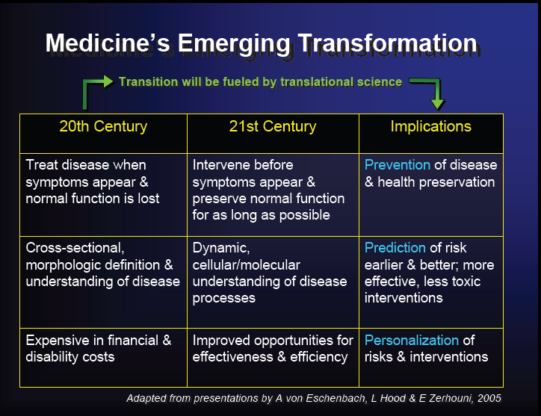
Translation Research in Precision Medicine

Slide 3
Liquid Biopsy: Various Forms
Circulating cell-free DNA (ccfDNA or cfDNA) refers to small DNA fragments shed by all cells into the circulation. This includes blood, lymph, urine, saliva, CSF, etc.
Circulating tumor DNA (ctDNA) refers to DNA shed specifically by tumor cells into the circulation.
Plasma tumor DNA (ptDNA) refers to the plasma component of ctDNA. Plasma has been shown to be a superior substrate versus serum for ctDNA analysis.
Circulating tumor cells, extracellular vesicles, tumor-associated cells
Crowley et al., Nat.Rev. Clin. Onc. 2013

Slide 4
Why Liquid Biopsy?
Noninvasive methods of cancer detection are advantageous.
Use of many biofluids (blood, urine, sputum, saliva, etc.).
Signatures of patients’ tumors can be now be characterized and can aid in understanding tumor biology as well as prove to be the best tool for early detection and monitoring of therapeutic response.
To date, there are no standards for capture, characterization, and evaluation of liquid biopsy markers for use in the setting of screening or early detection.

Slide 5
Technical Advantages of Liquid Biopsy
Repeated longitudinal sampling is possible. With tissue biopsy, this is difficult or impossible to carry out.
Technologies enable researchers and clinicians to employ a simple blood draw that will enable analysis of defined biomarkers.
Less invasive and generally less risk to patients, especially those who are not candidates for invasive biopsy.
Can be performed in the screening setting.

Slide 6
Potential Clinical Uses of Liquid Biopsy
Screening for genetic alterations in a fetus using maternal blood, already in clinical use
Biomarkers for inflammatory states, such as acute coronary events, autoimmune disease
Solid tumor organ rejection based on DNA differences between donor and recipient
Biomarkers for graft vs. host disease
Clinical biomarkers for oncology
Assessing response to therapies, identifying drug resistance clones, detecting minimal residual disease

Slide 7

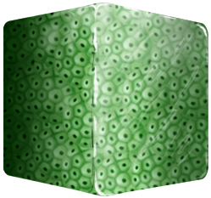
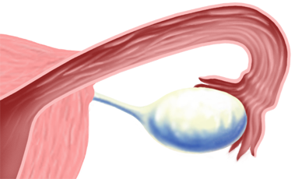
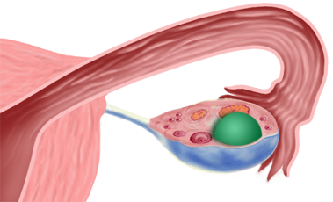



Challenges with Conventional Technology: Reach for the “Holy Grail” LB
10 mm
10 mm³
= 3 billion cells
10 mm
1 mm³
= 3 million cells
1 mm
1 mm
(0.1) ³ mm³
= 3 thousand cells
# 8
Notes:
7

Slide 8
Challenges: Technological and Biological
  Low levels of genetic targets:
Low levels of mutant ctDNA that is “diluted” with wild-type DNA; thus requiring large
volumes of blood.
Low capture efficiency (ctDNA detection varies from 49-78% in patients with localized disease).
Issues with specificity.
What is the clinically relevant fluid to sample?
Detection of low allelic variants in early-stage disease
Tumor heterogeneity:
  Is liquid biopsy representative of all the genetic clones of a tumor?
  Is there sample bias? (i.e., are all regions of the tumor the same?)
  What are the clinically relevant targets?

Slide 9







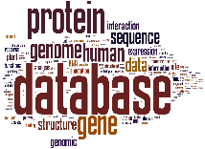
It Would Require Collaboration to Accomplish the Goals
The major challenges in liquid biopsy
What can we do to address them
Need standardized pre-analytical workflow
Recommendations from professional organizations (e.g., Association for Molecular Pathology, American Society of Clinical Pathology).
sample collection
stabilization
extraction
transportation
Heterogeneous patient populations
Broad and shallow genome-based approach as the alternative
common approaches based on small panels
More grants to bioinformatics efforts both for research and for small businesses
Lack of bioinformatics teams/tools
prevent many small to medium companies to enter this space
Scarcity of publicly available data
Release of sufficient data to reproduce the method should be a requirement by journals for publications
hard to reproduce the claimed accuracy
Notes:
There are four major challenges in liquid biopsy:
Standardized pre-analytical workflow, from sample collection, stabilization, transportation and extraction. Variability in each stage can affect the final result. For example, the quantity and qualify of cfDNA will vary depending on whether the samples was collected in an EDTA or Streck tubes.
2. Common approaches are usually based on small panels, so cannot cover broad and heterogeneous patient populations. The largest panel so far is around 500 genes.
3. few bioinformatics tools are available to facilitate the analysis of liquid biopsy data, although liquid biopsy shows great promise in many applications. Take cfDNA as example, cfDNA sequencing data possess unique properties that are not addressed by existing methods, therefore bioinformatics analysis is currently the major bottleneck or barrier preventing many diagnostic companies from entering the liquid biopsy market. Currently, no comprehensive cfDNA bioinformatics analyses and variant annotation platforms exist for clinical use.
4. Publicly available liquid biopsy data is scarce to reproduce the accuracy claimed in literatures and commercial products.
We can address these suggestions by the following actions.
For the first challenge, professional organizations (e.g. Association for Molecular Pathology, American Society of Clinical Pathology) shall establish recommendations on the standardized workflows.
For the second challenge, we can use the broad and shallow genome-based approach as the alternative. For example, CancerDetector is a recent methylome-based approach that can sensitively detect cancer with shallow whole-genome sequencing data (Li et al. 2018). Another example is a copy number alteration (CNA) method that uses the shallow whole-exome sequencing data (Viktor et al. 2017).
For the third challenge, we can fund more grants on bioinformatics efforts both for research and for small businesses.
For the fourth challenge, journals shall require data and code release upon the publication of the paper, in order for independent effort to replicate the results.

Slide 10
Liquid Biopsy Offers an Environment Suitable for Precompetitive Collaboration
Opportunities for collaboration on data sharing, data integration and standards; results from the verification of a product and technology performance can be used to inform additional discovery efforts.
Private sector will have opportunities to quickly improve their return on investment through collaboration on validating their technologies.

Slide 11
Precompetitive Collaboration?
Offers an opportunity for collectively developing standards, data, and processes to accelerate technology development and validation.
Accepted as a driver for improved efficiency, while simultaneously improving our understanding of increasing complexity.
Efficient utilization and sharing of resources allows effective movement to market competition.
Pharmaceutical Companies use Precompetitive Collaboration, a term used when competitors share early stages of research and development that are beneficial to all stakeholders.

Slide 12
NCI Precompetitive Collaboration on Liquid Biopsy:
The Liquid Biopsy Consortium (LBC)
Promotes Public-Private Partnership to develop new and/or validate existing technologies, methods, and assays for the capture and quantification of tumor associated cells, DNA, RNA, or exosomes in body fluids of patients with early-stage disease or those at high risk.
Develops precompetitive alliances with industry to harmonize and validate technologies, methods, and assays associated with liquid biopsies.
Emphasis on:
    early cancer detection;
    distinguishing benign disease from cancer;
    distinguishing aggressive from nonaggressive cancers;
    use with other classes of biomarkers to improve detection accuracy, reproducibility and predictability.

Slide 13




Areas Where Academic and Industry Partners Can Bring Liquid Biopsy to Clinical Fruition
Original technologies and clinical resources
Funds and production pipelines
Provide
Provide
Ideal partnership would be to validate the technologies (from industry/academia) via large-scale clinical trials using industry financial resources
Academia
Industry
CHALLENGE
CHALLENGE
How to secure funds for medium-scale clinical validation
How to recognize truly exceptional technologies, which need to be validated in at least medium-scale trial
Notes:
Academic partners can offer original technologies and clinical resources; and industry partner can offer funds and production pipelines
The ideal partnership would be to validate the technologies (from academia) via large-scale clinical trials using industry financial resources
The challenge for industry is to recognize truly exceptional technologies, which need to be validated in at least medium-scale trial; and the challenge for academia is to secure funds for medium-scale clinical validation. NIH funds could bridge those two needs, and therefore facilitate fruitful collaborations.

Slide 14
LB May Revolutionize Cancer Detection: Multicancer Early Detection Test
Paucity of single markers that have the prerequisite sensitivity and specificity to detect a particular cancer type (single organ screening)
Potential efficiency of universal cancer screening (UCS) in detecting cancers originating from multiple organ sites using markers that are either specific for a cancer type or common for multiple cancers
Aggregate sample size provides better statistical power with screening for multiple cancers compared to single cancer screening

Slide 15
Summary
Liquid Biopsy detection can change the paradigm and rationale for how we administer systemic therapies in early-stage breast and other solid cancers
Can avoid overtreatment and undertreatment
Allows for individualized precision medicine; treat patients with exactly what they need; not too little, not too much
To get there, we will need the same level of evidence required for new drug approval, i.e., prospective randomized trials demonstrating clinical utility

Slide 16
Thank you

Slide 17
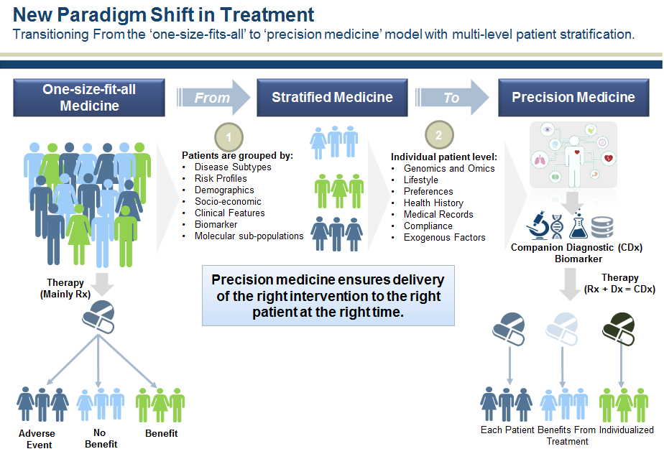
New Paradigm Shift in Treatment

Slide 18
What is Liquid Biopsy?
A test performed on a sample of blood to look for circulating analytes, e.g., DNA, RNA, proteins, metabolites, etc., shed from a tumor. Liquid biopsy may be used to help find cancer at an early stage.

Slide 19
Proving Liquid Biopsy

Slide 20
NGS Offers Better Sensitivity: Liquid Pap Smears (cervico-vaginal fluid) Capture and Sequencing of the DNA ⁽⁴⁾
Detection:
Endometrial 100%
Ovarian 44%
Tumor cells shed from ovarian or endometrial cancers are carried into the endo-cervical canal. These cells can be captured by the brush used for performing a routine Pap smear. The brush contents are transferred into a liquid fixative, from which DNA is isolated. By means of massively parallel sequencing, this DNA is queried for mutations that indicate the presence of a malignancy in the female reproductive tract.
(4) Kinde, et. al., Sci Transl Med (2013) Jan. 9: 5(167)

Slide 21
Competitive Landscape for Liquid biopsy
Competitive Landscape for Liquid biopsy: Examples of liquid biopsy tests on the market
Companies | Company Description | Liquid Biopsy Offering
Biocept (BIOC) | Focused on developing cell-free tests using proprietary technology platform that captures and analyzes ctDNA in both CTC and plasma | NGS-based tests for assessing targeted mutations non-small cell lung, gastric, and breast cancers
Chronix Biomedical* | The company discovered biomarkers present in most major cancers, which they will use to identify individual biomarkers using NGS and then develop cost-effective PCR-based tests to monitor relapse | NGS-based test to monitor breast cancer
Cynvenio* | Focused on developing liquid biopsy tests for patients that cannot undergo standard biopsy procedures | ClearID: NGS evaluation of CTC for advanced breast cancer patients
Epic Sciences* | Founded by Dr. Peter Kuhn from Scripps Research Institute | CTC Odyssey assay analyzes the CTCs isolated for biomarkers
Exosome Diagnostics* | Focused on developing exosome-based diagnostics by isolating exosomes from biofluids (including plasma/serum, urine, CSF and saliva) to assess genetic content using NGS | NGS approach to evaluate mutations found in lung cancers, solid tumors and urine-based prostate cancer using RNA and DNA from exosomes.
Guardant Health* | Co-founded by the former Sr. Director of Advanced Technology Research and Sr. Director of Diagnostics Research from Illumina | Guardant360: NGS evaluation for mutations on targeted genes in ctDNA
Personal Genome Diagnostics* | Founded by pioneers in the liquid biopsy field from JHU | NGS evaluation of mutations for multiple targeted genes in ctDNA
Qiagen (QGEN) | Leader in sample kit preps, currently offers sample prep kit to isolate circulating nucleic acids | CE-IVD marked CDx liquid biopsy kit to assess EGFR mutation in NSCLC for use with IRESSA
Resolution Biosciences* | Focused on developing NGS-based tests to sequence mutations | Currently offers a cancer panel, ctDx Lung, that sequence commonly found mutations in lung cancer from blood
Trovagene (TROV) | Focused on developing urine-based and blood-based cell-free molecular diagnostic tests in infectious disease and cancer | ctDNA PCR assay of BRAF, KRAS, EGFR mutations for CDx
Grail | Focused on early detection technologies based on liquid biopsy | cfDNA, methylation assays, NGS
Thrive (CancerSeek) | Focused on early detection technologies based on liquid biopsy | cfDNA, mutation assays, proteomics, metabolomics
Sources: Company disclosures, J.P. Morgan estimates

Slide 22
LBC Encourages Research Where Liquid Biopsy May be Most Beneficial
Examples:
Where problems exit that are associated with current screening methodologies;
Where no tools exit for noninvasive detection/monitoring of disease progression;
Where no noninvasive tools exit for early detection in “high risk” populations (genetic and/or familial predispositions).

